Slide 1
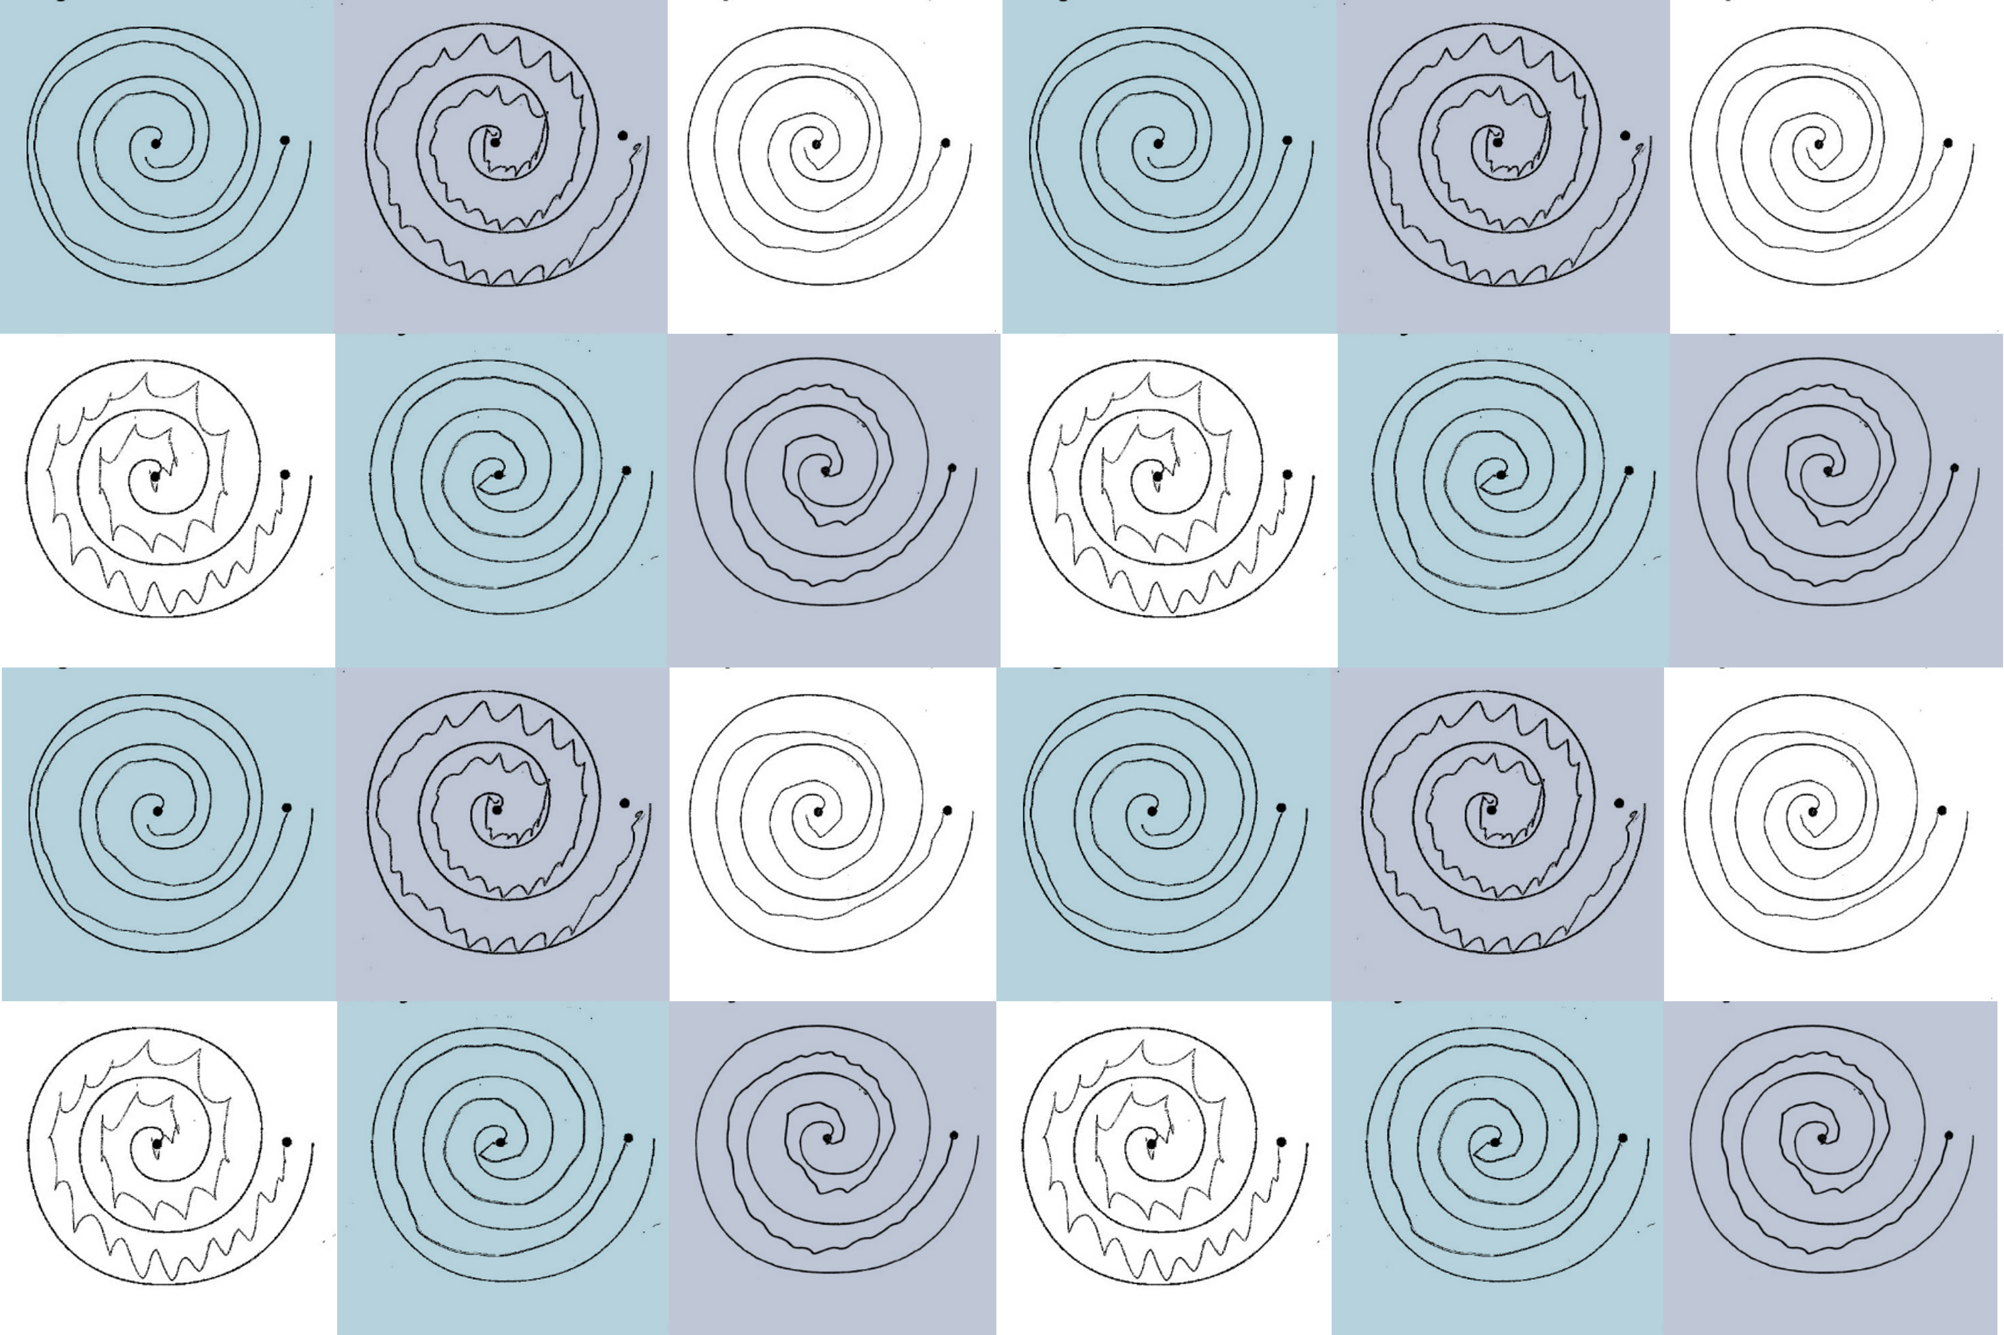
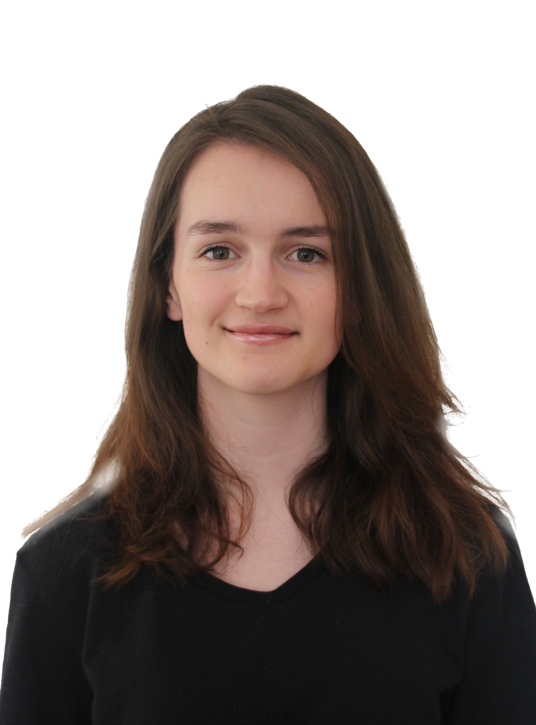
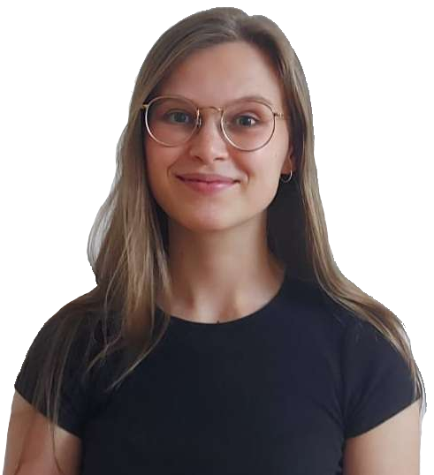
Which Hand?
Robyn Gebbie and Jesse van der Merwe
Project 22P59, Group 22G05

Slide 2
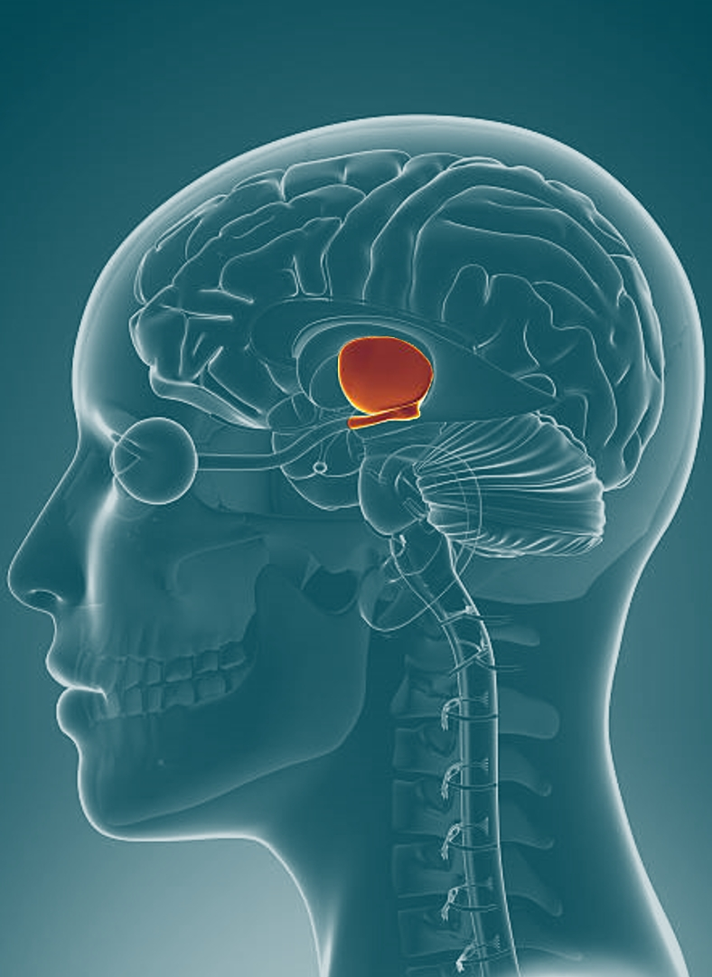
Focused Ultrasound Treatment
Focused Ultrasound is used to treat Parkinson’s Disease and Essential Tremor
This treatment delivers acoustic energy to one side of the patient’s thalamus
This process causes small lesions to form on this part of the brain, interrupting abnormal brain activity and causing the patient to have fewer uncontrollable movements, such as tremor
This treatment only improves the tremor on one side of the patient’s body

Slide 3
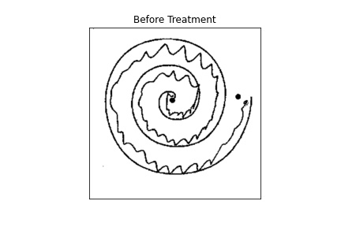
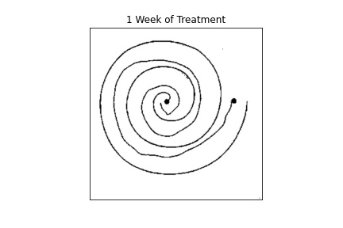
Before Treatment
After Treatment

Slide 4
Data & Pre-Processing

Slide 5
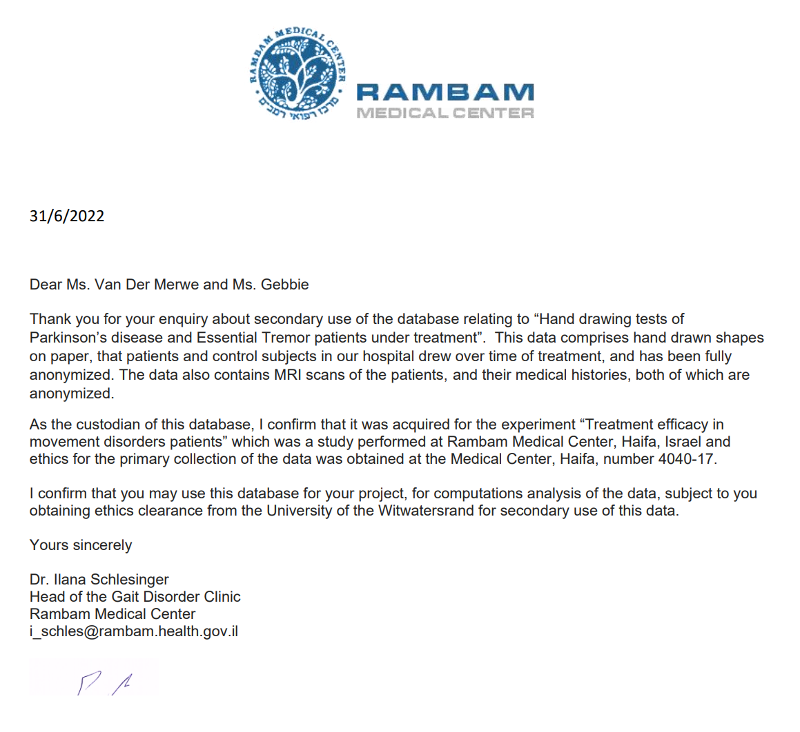
Data: Overview
Fully anonymised data provided by the Rambam Medical Centre, Haifa, Israel.
Ethical clearance obtained from University of Witwatersrand HREC Committee (Medical).
122 patients total:
34 with Parkinson’s disease
88 with essential tremor

Slide 6
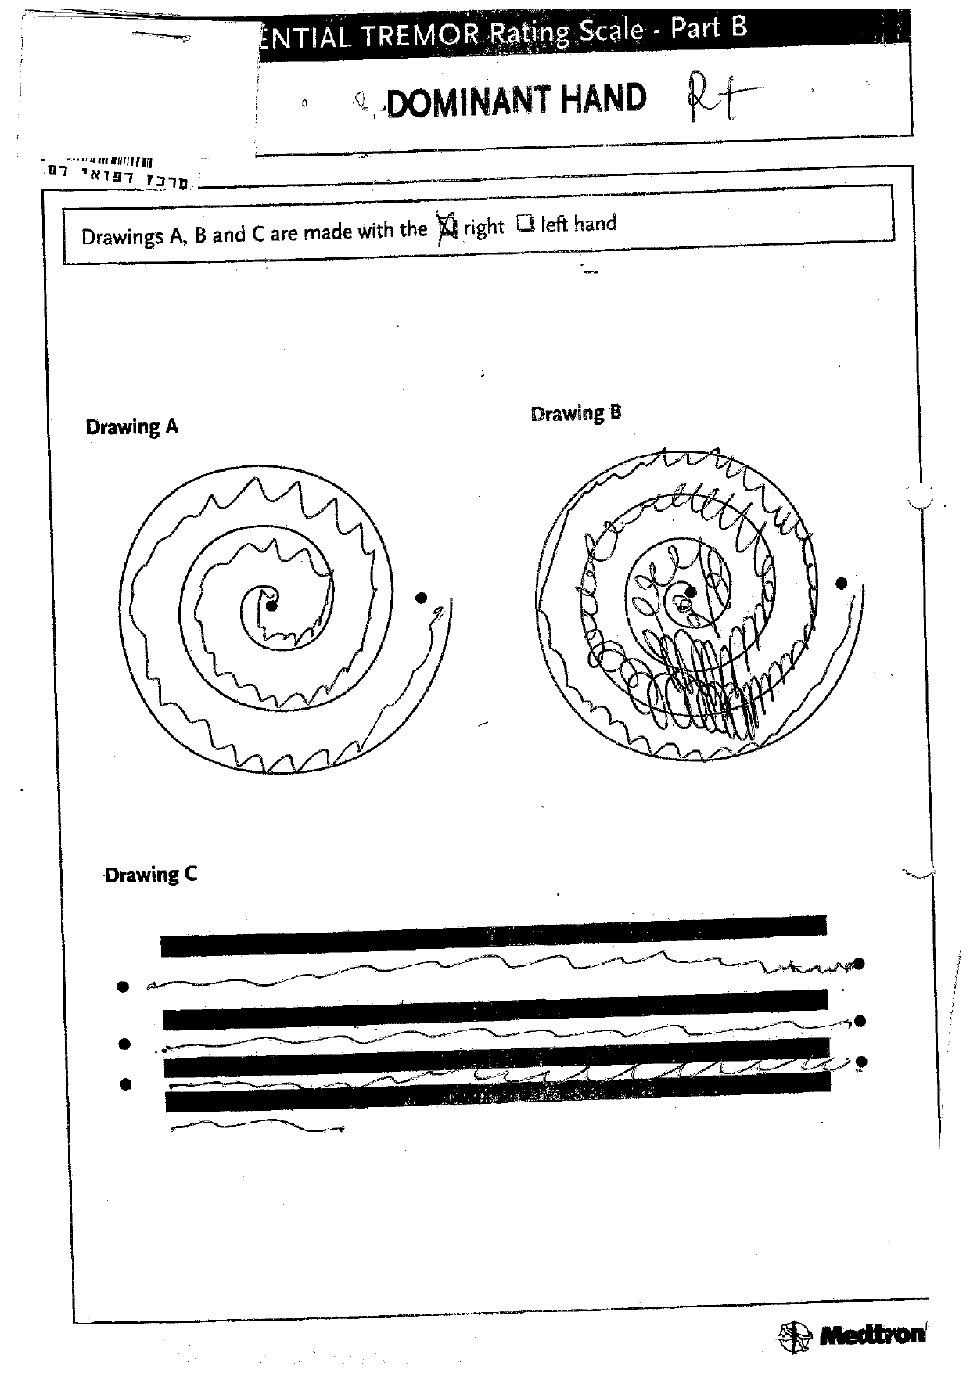
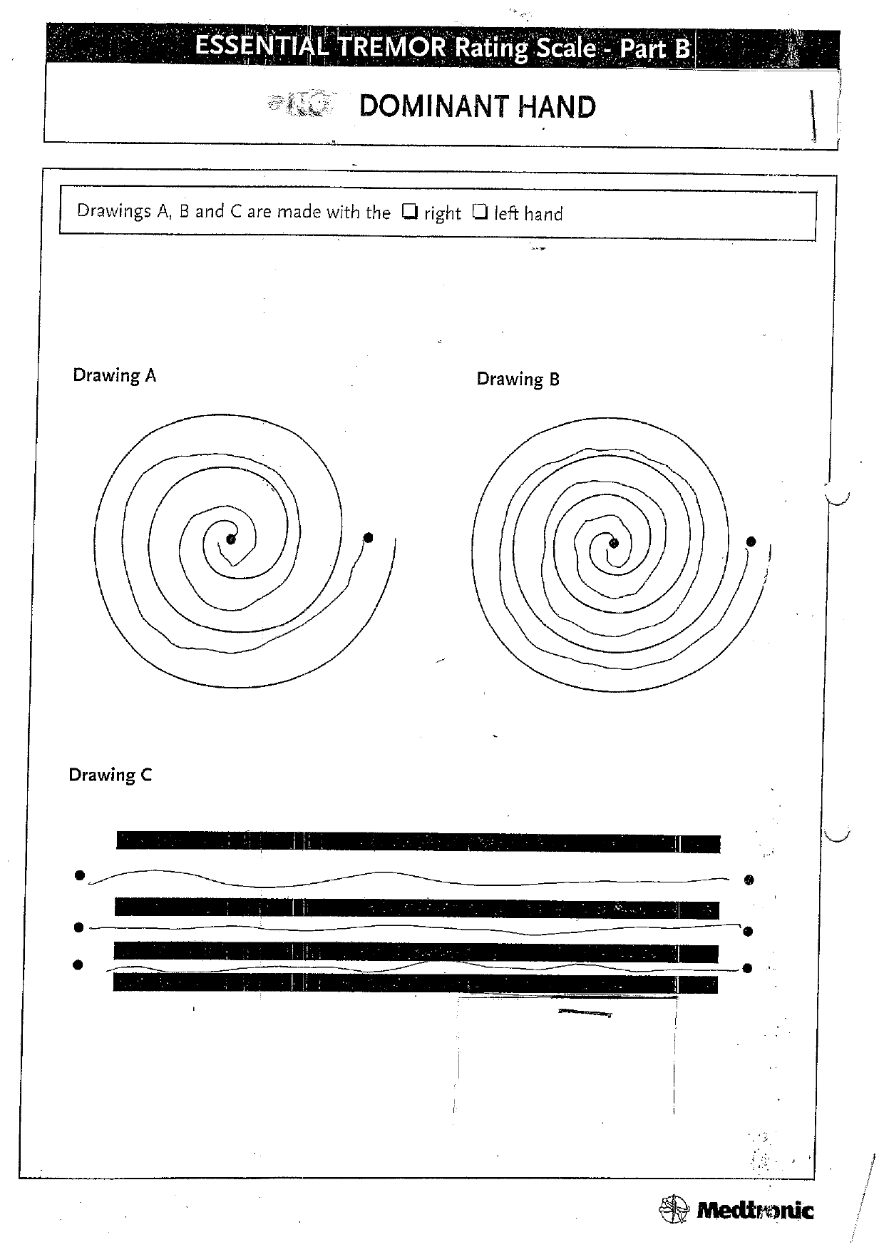
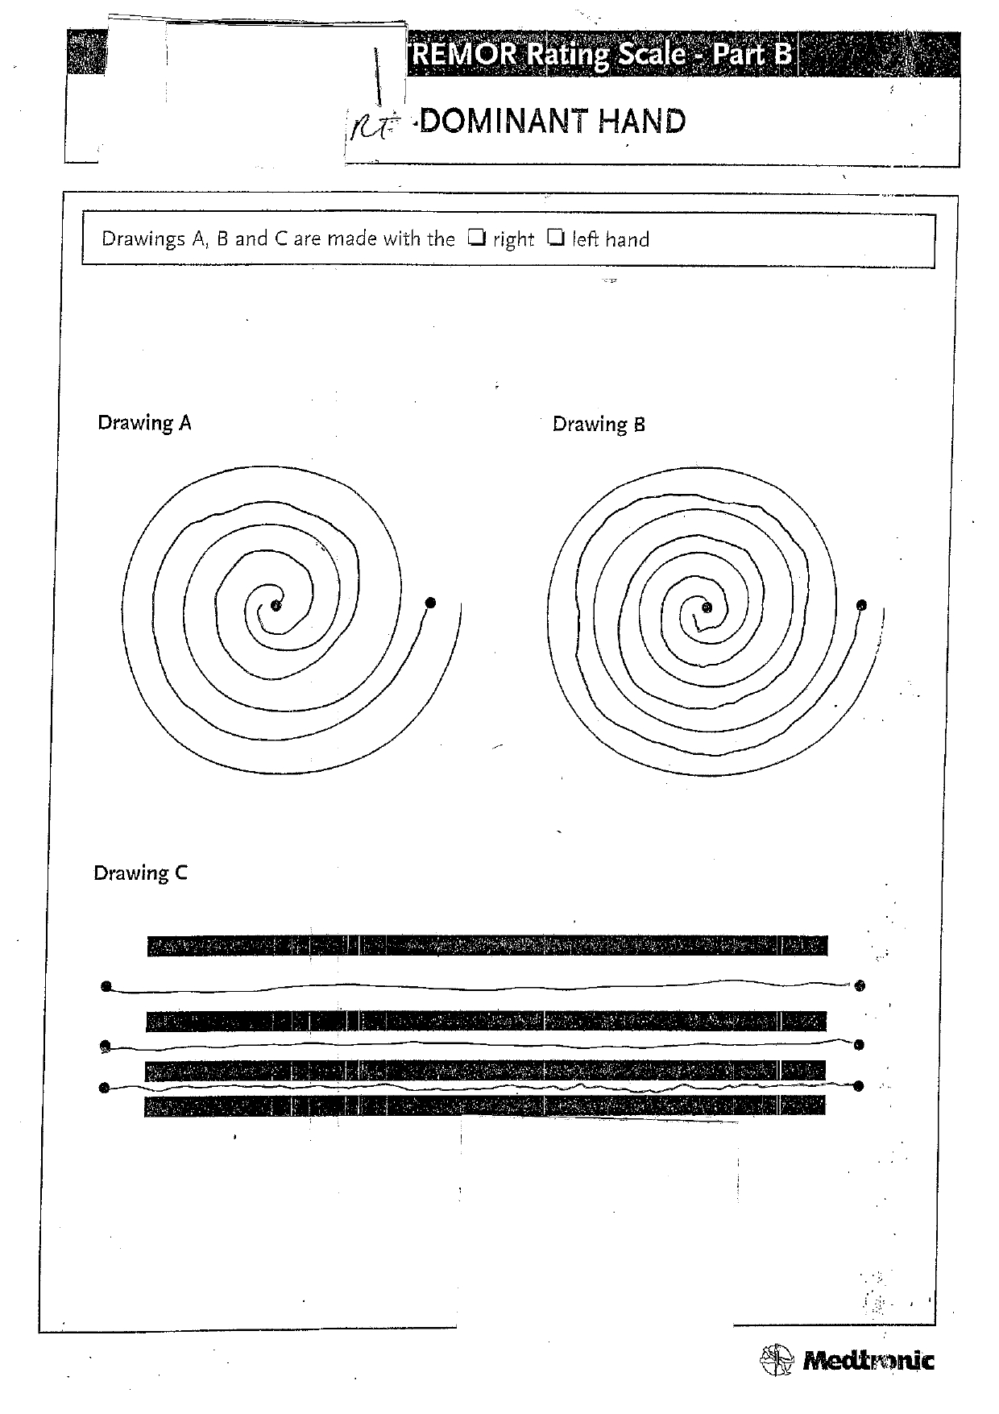
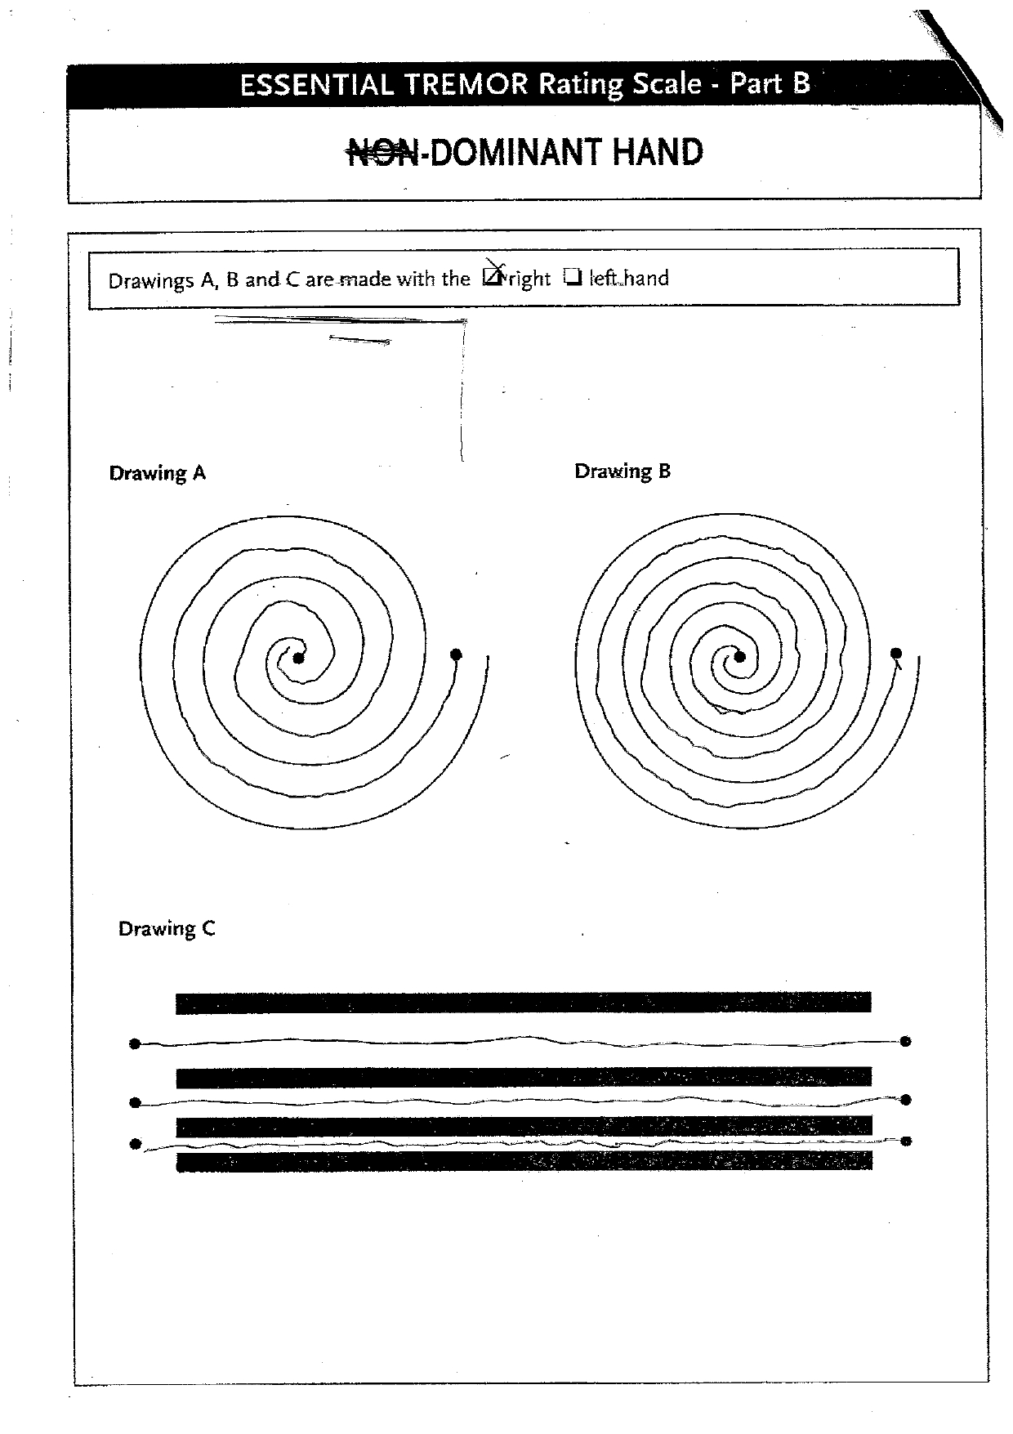
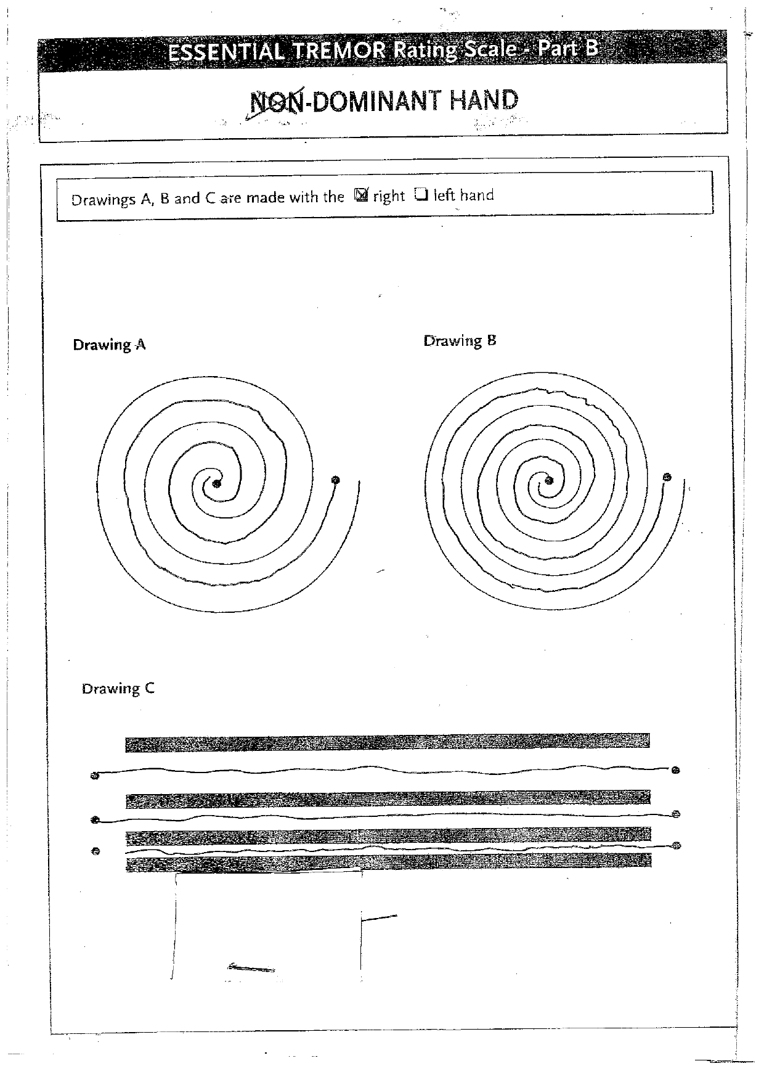
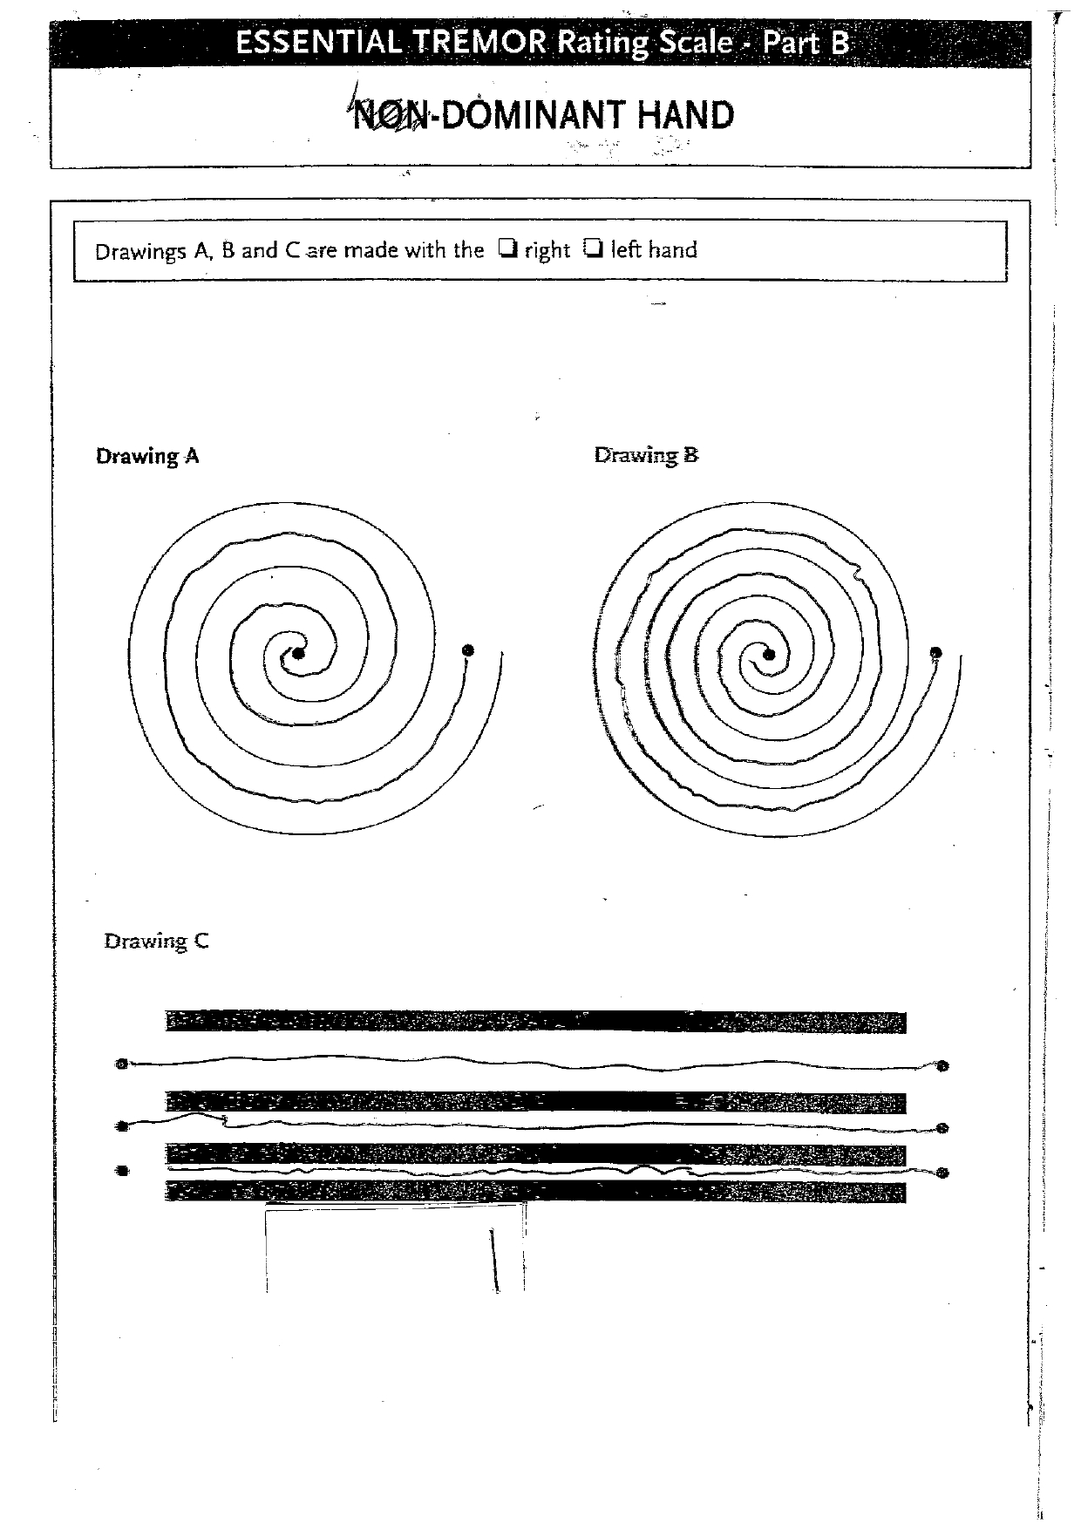
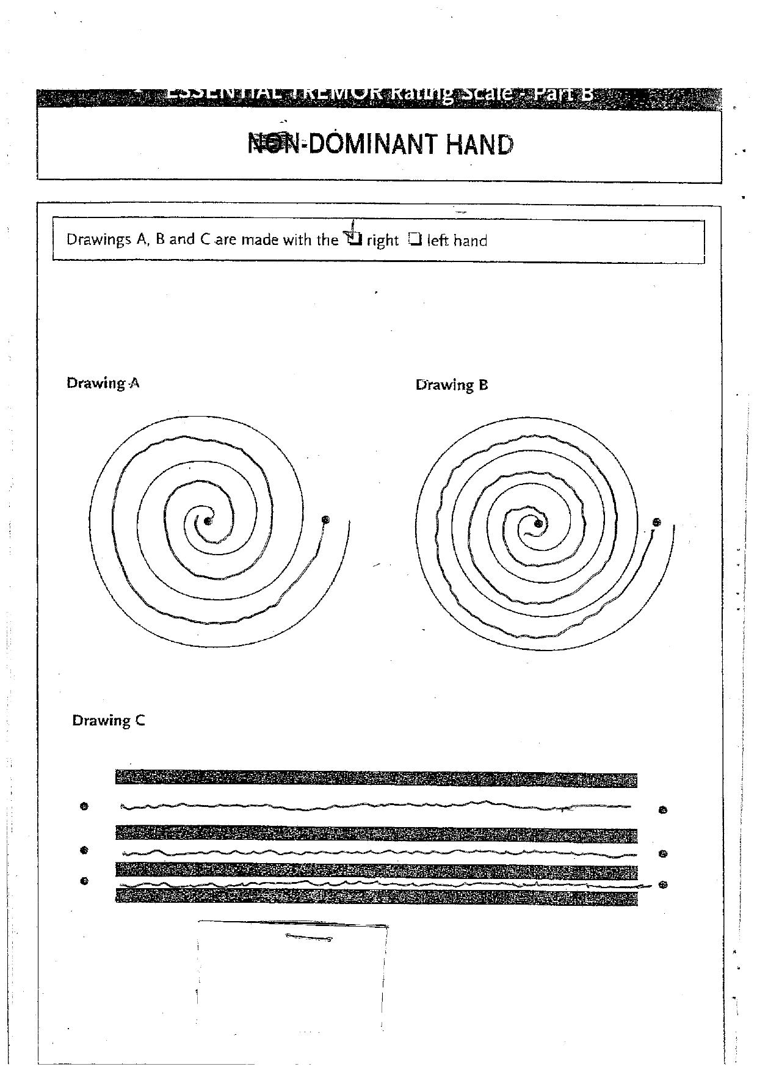
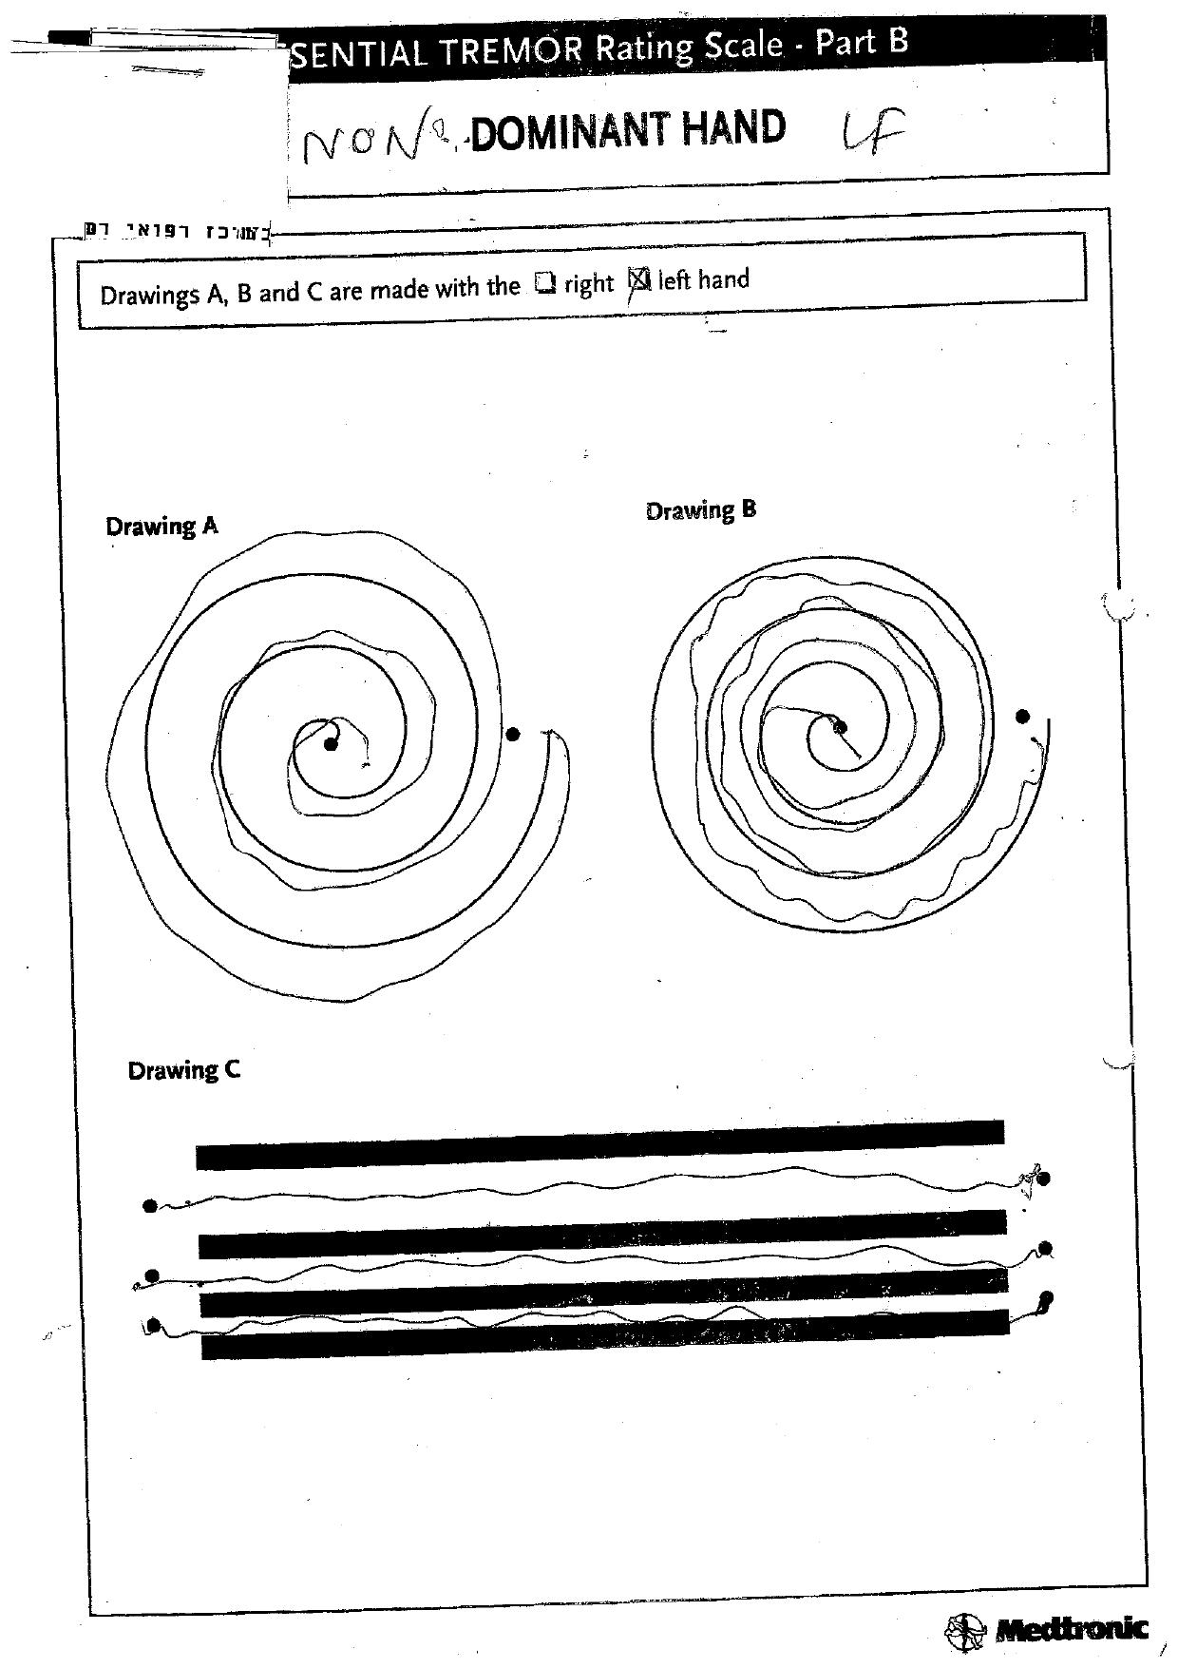
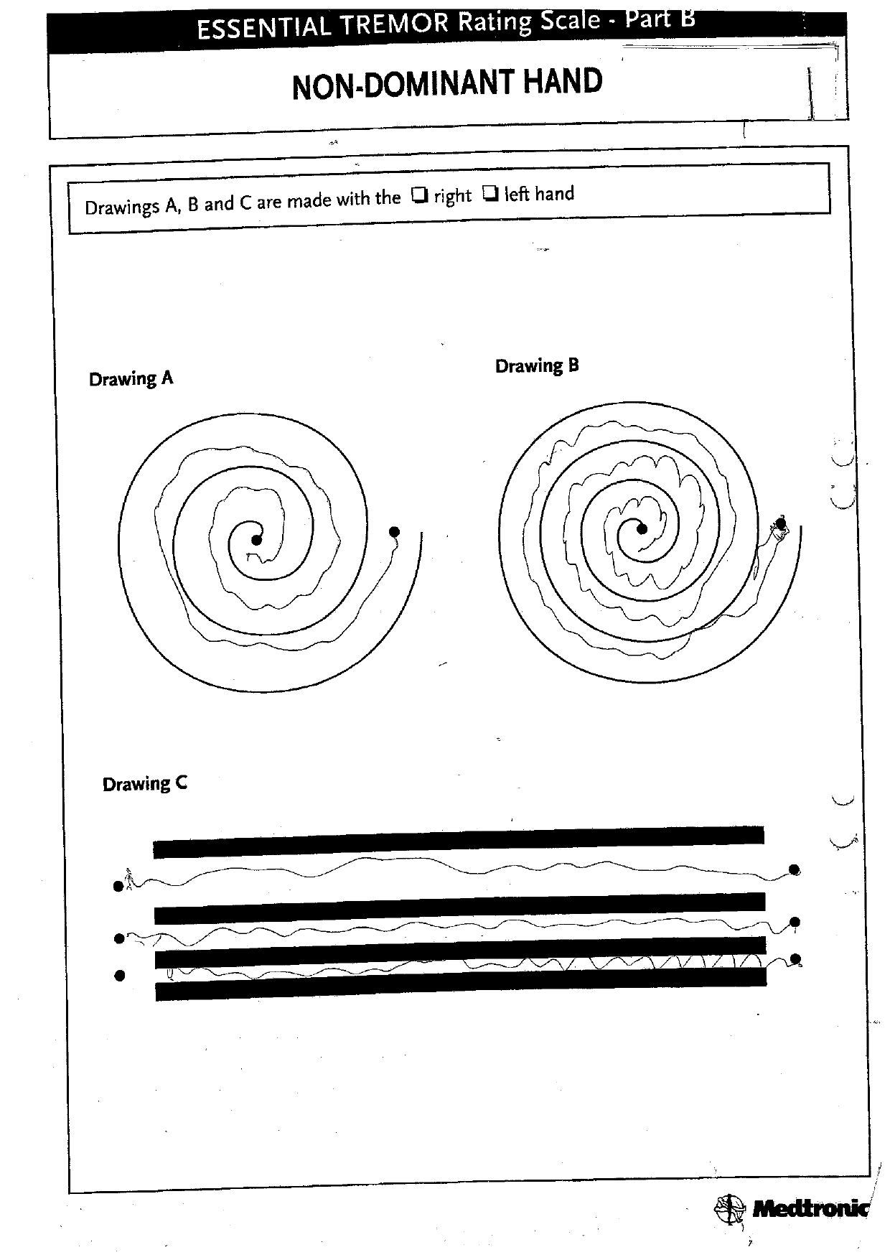
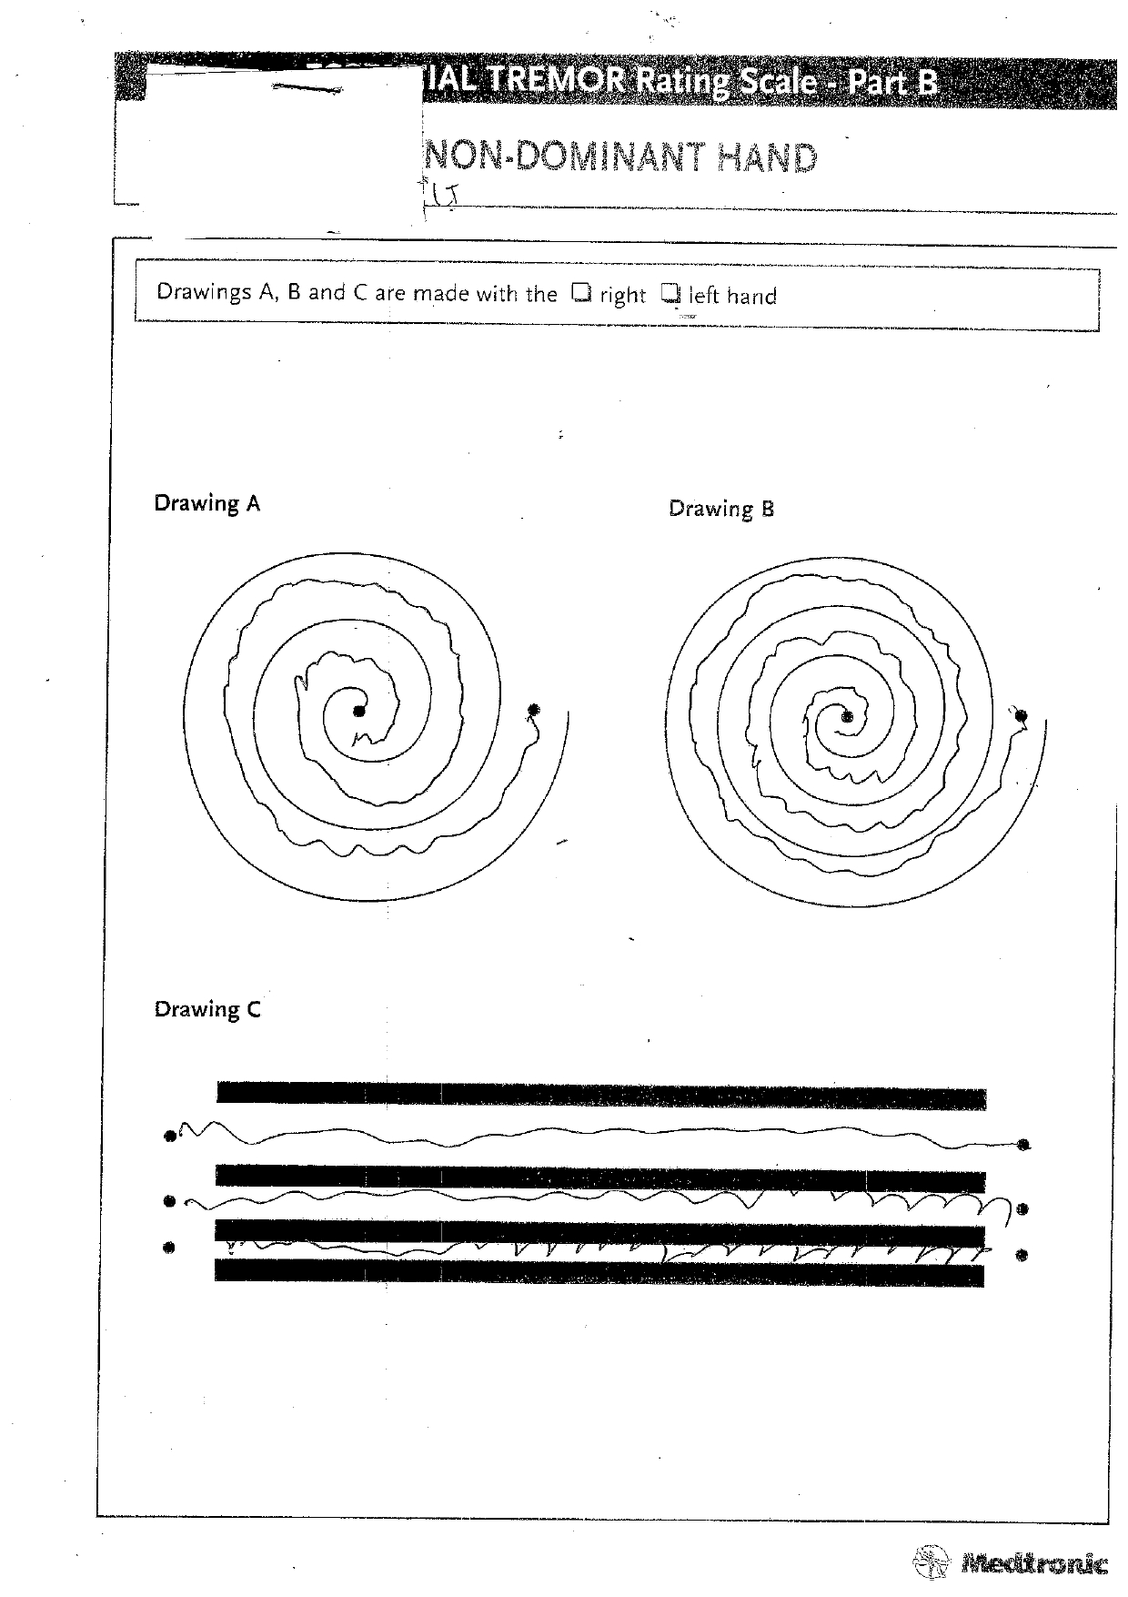
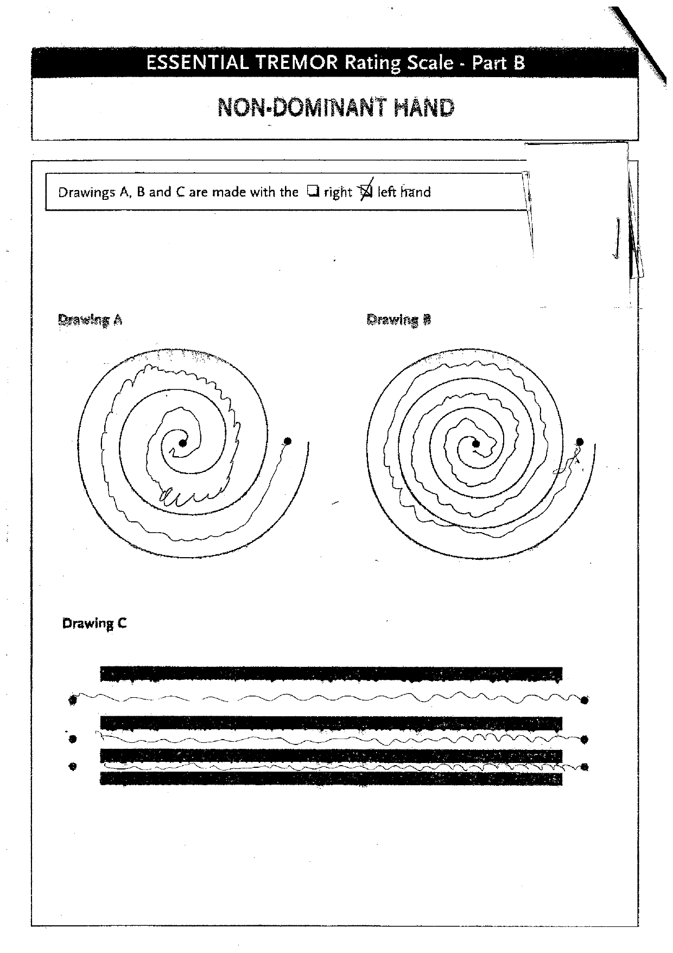
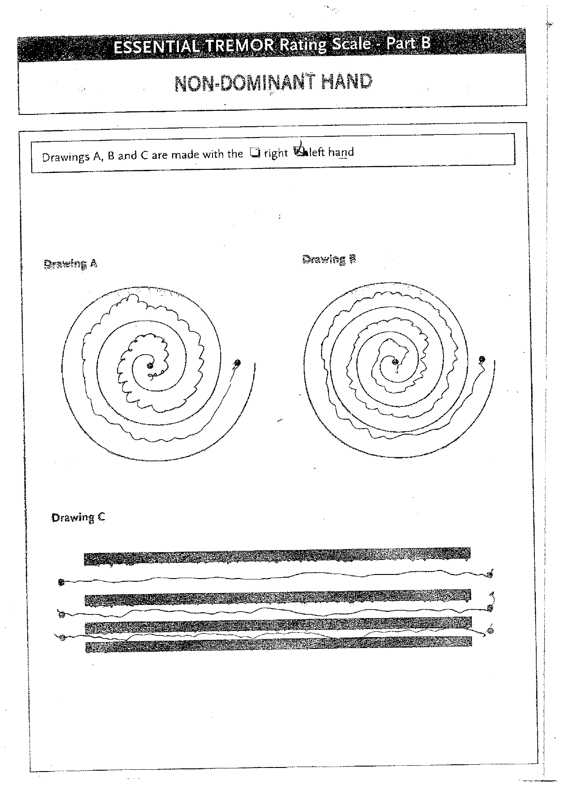
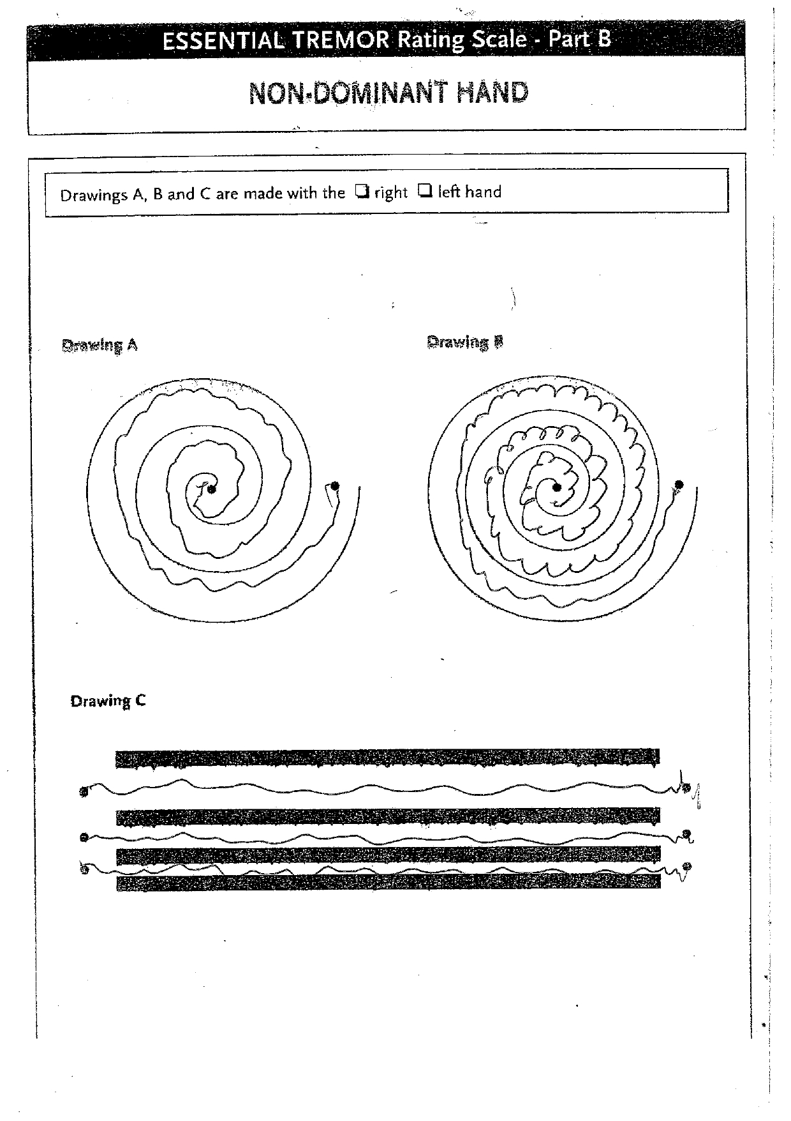
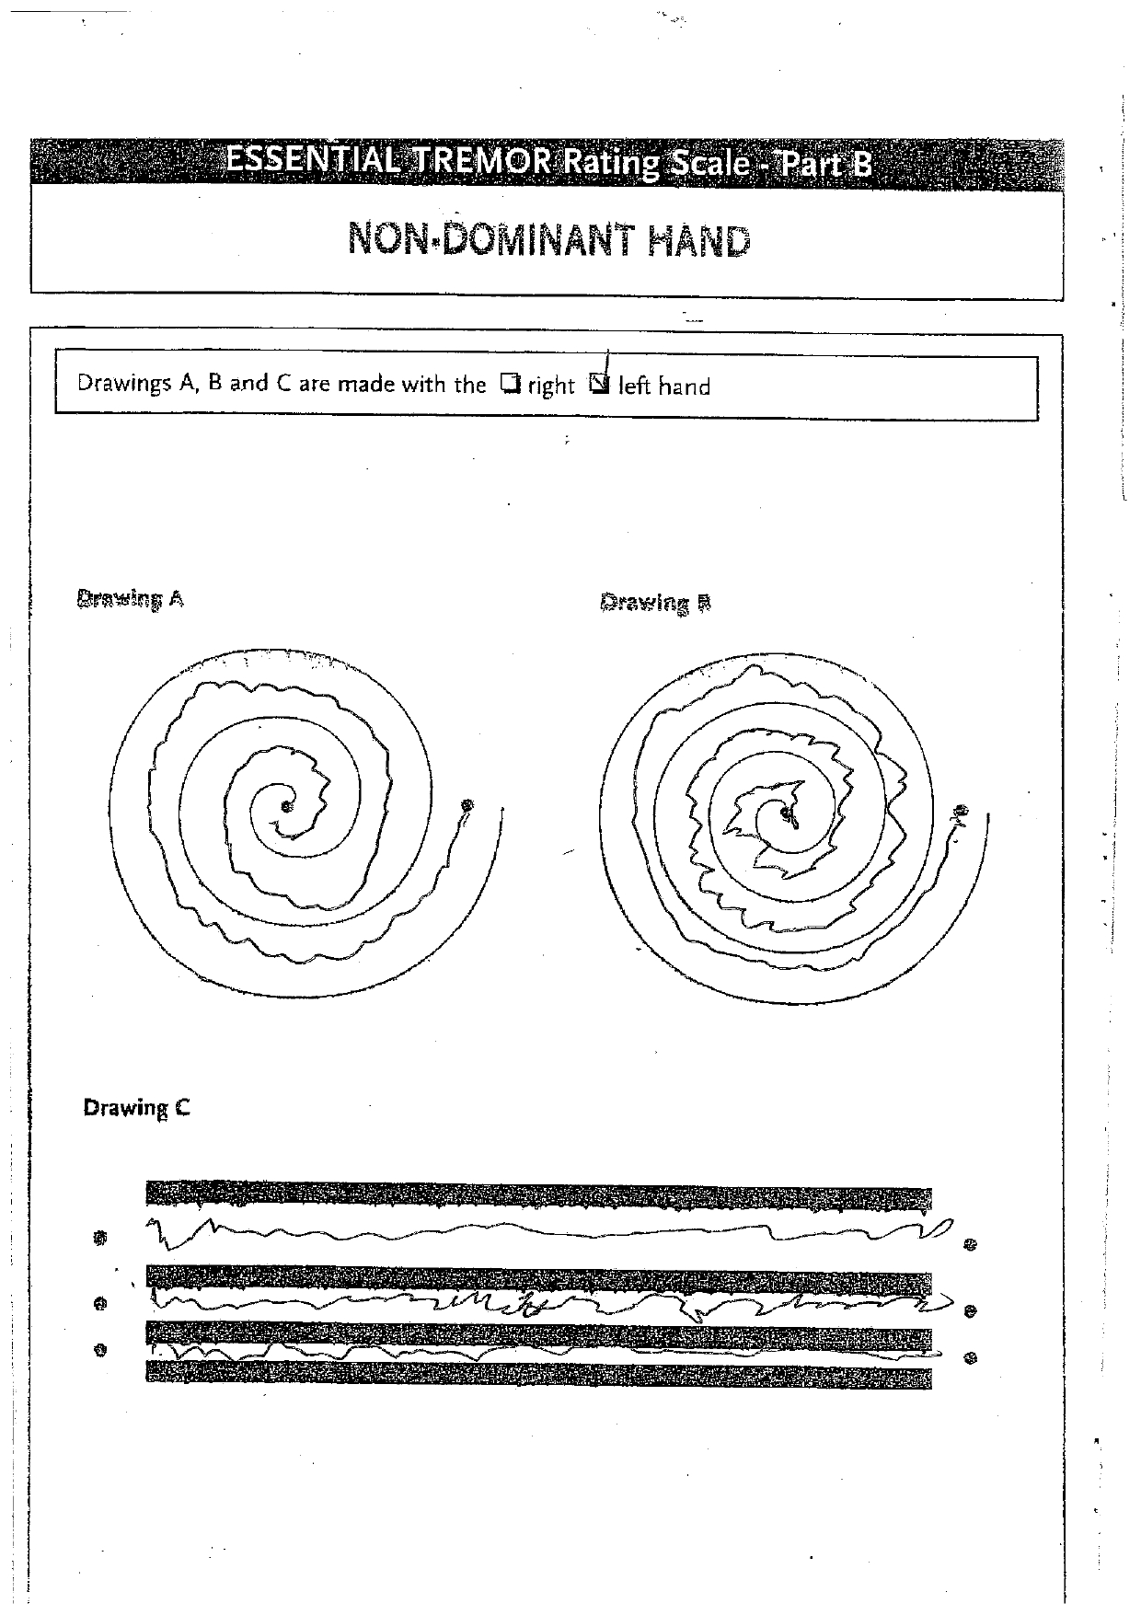
Data: Patient #5 Example
Hand | Before | 1 Week | 1 Month | 3 Months | 6 Months | 1 Year | 2 Years | 3 Years | 4 Years | 5 Years…
TREATED
UNTREATED
MISSING DATA
MISSING DATA
MISSING DATA
MISSING DATA
MISSING DATA
MISSING DATA

Slide 7
Data: Patient #5 Example
Hand | Before | 1 Week | 1 Month | 3 Months | 6 Months | 1 Year | 2 Years | 3 Years | 4 Years | 5 Years…
TREATED
UNTREATED
MISSING DATA
MISSING DATA
MISSING DATA
MISSING DATA
MISSING DATA
MISSING DATA

Slide 8
Data: Patient #5 Example
BEFORE TREATMENT
Hand | Before | 1 Week | 1 Month | 3 Months | 6 Months | 1 Year | 2 Years | 3 Years | 4 Years | 5 Years…
TREATED
UNTREATED
MISSING DATA
MISSING DATA
MISSING DATA
MISSING DATA
MISSING DATA
MISSING DATA

Slide 9
Data: Patient #5 Example
BEFORE TREATMENT
AFTER TREATMENT
Hand | Before | 1 Week | 1 Month | 3 Months | 6 Months | 1 Year | 2 Years | 3 Years | 4 Years | 5 Years…
TREATED
UNTREATED
MISSING DATA
MISSING DATA
MISSING DATA
MISSING DATA
MISSING DATA
MISSING DATA

Slide 10
Data Pre-Processing: Overview
1
2
3
4
Image Isolation Code
Kelvin da Silva: “Tremor Classification”
Adrian Rosebrock: “OpenCV Text Detection (EAST text detector)”
Extraction of Line-Block C
Extending original code to also extract line-drawing C
Improvement of Original Code
Better logic checks
Improved error checking
Extract Line-C with Rotation/Warp Correction
Adrian Rosebrock: “OpenCV shape detection”
jdhao: “Cropping Rotated Rectangles from Image with OpenCV”

Slide 11
Data Pre-Processing: Image Isolation Code
1
Kelvin da Silva’ spiral isolation code: Logic

Slide 12
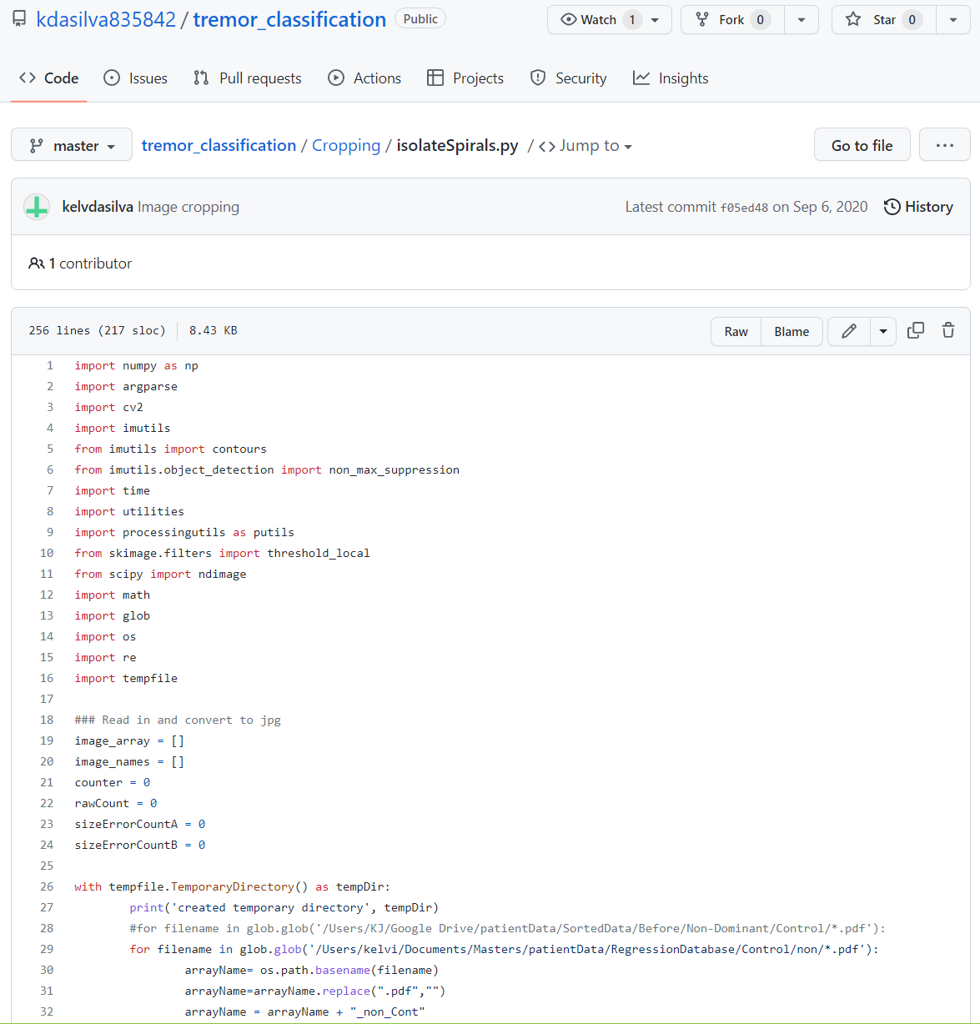
Data Pre-Processing: Image Isolation Code
1
Kelvin da Silva’ spiral isolation code: Advantages
Text detection is challenging – not part of project scope
Based on article by Adrian Rosebrock: “OpenCV Text Detection (EAST text detector)”
Efficient and Accurate Scene Text detection pipeline
Deep learning based text detection
https://github.com/kdasilva835842/tremor_classification/blob/master/Cropping/isolateSpirals.py

Slide 13
Data Pre-Processing: Image Isolation Code
1
Kelvin da Silva’ spiral isolation code: Disadvantages
Does not include sufficient error correction, only removal
Deep learning-based text detection might be overkill considering the template format of each image
Detects any and all text – picks up erroneous markings
Simpler and more efficient methods available
https://github.com/kdasilva835842/tremor_classification/blob/master/Cropping/isolateSpirals.py

Slide 14
Data Pre-Processing: Extracting Line-Block C
2
Expanding the code to extract the line-block C

Slide 15
Data Pre-Processing: Improving the Code
3
Logic checks: Remove extra detected text

Slide 16
Data Pre-Processing: Improving the Code
3
Error correction: Missing “Drawing A”

Slide 17
Data Pre-Processing: Improving the Code
3
Error correction: Missing “Drawing B”

Slide 18
Data Pre-Processing: Improving the Code
3
Error correction: Missing “Drawing C”

Slide 19
Data Pre-Processing: Extracting Line C with Warp Correction
4
The extracted line-block C

Slide 20
Data Pre-Processing: Extracting Line C with Warp Correction
4
Extracting line-drawing C with rotation/warp correction
Poor detection
REFERENCES:
Adrian Rosebrock: “OpenCV shape detection” – https://pyimagesearch.com/2016/02/08/opencv-shape-detection/

Slide 21
Data Pre-Processing: Extracting Line C with Warp Correction
4
Extracting line-drawing C with rotation/warp correction
Poor detection
REFERENCES:
Adrian Rosebrock: “OpenCV shape detection” – https://pyimagesearch.com/2016/02/08/opencv-shape-detection/

Slide 22
Data Pre-Processing: Extracting Line C with Warp Correction
4
Extracting line-drawing C with rotation/warp correction
Poor detection More accurate detection

Slide 23
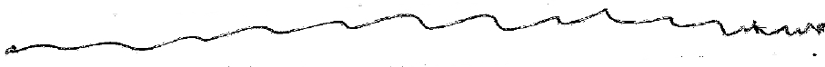
Data Pre-Processing: Extracting Line C with Warp Correction
4
Extracting line-drawing C with rotation/warp correction
Poor detection More accurate detection Corrected image
REFERENCES:
jdhao: “Cropping Rotated Rectangles from Image with OpenCV” – https://jdhao.github.io/2019/02/23/crop_rotated_rectangle_opencv/

Slide 24
Data Pre-Processing: Overview
1
2
3
4
Image Isolation Code
Kelvin da Silva: “Tremor Classification”
Adrian Rosebrock: “OpenCV Text Detection (EAST text detector)”
Extraction of Line-Block C
Extending original code to also extract line-drawing C
Improvement of Original Code
Better logic checks
Improved error checking
Extract Line-C with Rotation/Warp Correction
Adrian Rosebrock: “OpenCV shape detection”
jdhao: “Cropping Rotated Rectangles from Image with OpenCV”

Slide 25
Data Pre-Processing: Overview
1
2
3
4
Image Isolation Code
Kelvin da Silva: “Tremor Classification”
Adrian Rosebrock: “OpenCV Text Detection (EAST text detector)”
Extraction of Line-Block C
Extending original code to also extract line-drawing C
Improvement of Original Code
Better logic checks
Improved error checking
Extract Line-C with Rotation/Warp Correction
Adrian Rosebrock: “OpenCV shape detection”
jdhao: “Cropping Rotated Rectangles from Image with OpenCV”
Method 1: Method 2: Spiral A Line-drawing C

Slide 26
Method 1

Slide 27
Spiral Tremor Quantification
Preparation
Images were resized.
x and y coordinates of the spiral pixels were extracted.
Sobel Edge Detection
The angles made by the gradients of the spiral edges were determined
Pixel Angles
The angle that each pixel made with a horizontal line through the spiral centre was determined
Relative Orientations
The angles made by the gradients of the spiral edges relative to the centre of the spiral were determined.

Slide 28
Spiral Tremor Quantification
Preparation
Images were resized.
x and y coordinates of the spiral pixels were extracted.
Sobel Edge Detection
The angles made by the gradients of the spiral edges were determined
Pixel Angles
The angle that each pixel made with a horizontal line through the spiral centre was determined
Relative Orientations
The angles made by the gradients of the spiral edges relative to the centre of the spiral were determined.

Slide 29
Spiral Tremor Quantification
Preparation
Images were resized.
x and y coordinates of the spiral pixels were extracted.
Sobel Edge Detection
The angles made by the gradients of the spiral edges were determined
Pixel Angles
The angle that each pixel made with a horizontal line through the spiral centre was determined
Relative Orientations
The angles made by the gradients of the spiral edges relative to the centre of the spiral were determined.

Slide 30

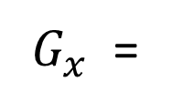
Vertical Sobel Filter Convolved with Image Array
-4
-3
-2
-1
0
1
2
3
4
-5
-4
-3
-2
0
2
3
4
5
-6
-5
-4
-3
0
3
4
5
6
-7
-6
-5
-4
0
4
5
6
7
$G_{x}$ =
-8
-7
-6
-5
0
5
6
7
8
$$∗$$
-7
-6
-5
-4
0
4
5
6
7
-6
-5
-4
-3
0
3
4
5
6
-5
-4
-3
-2
0
2
3
4
5
-4
-3
-2
-1
0
1
2
3
4

Slide 31

Calculation of the Orientation of an Edge Gradient
$$φ$$

Slide 32
Spiral Tremor Quantification
Preparation
Images were resized.
x and y coordinates of the spiral pixels were extracted.
Sobel Edge Detection
The angles made by the gradients of the spiral edges were determined
Pixel Angles
The angle that each pixel made with a horizontal line through the spiral centre was determined
Relative Orientations
The angles made by the gradients of the spiral edges relative to the centre of the spiral were determined.

Slide 33
Finding the Spiral Centre

Slide 34

Finding the Angle a Pixel Makes with the Spiral Centre
$$α$$

Slide 35
Spiral Tremor Quantification
Preparation
Images were resized.
x and y coordinates of the spiral pixels were extracted.
Sobel Edge Detection
The angles made by the gradients of the spiral edges were determined
Pixel Angles
The angle that each pixel made with a horizontal line through the spiral centre was determined
Relative Orientations
The angles made by the gradients of the spiral edges relative to the centre of the spiral were determined.

Slide 36
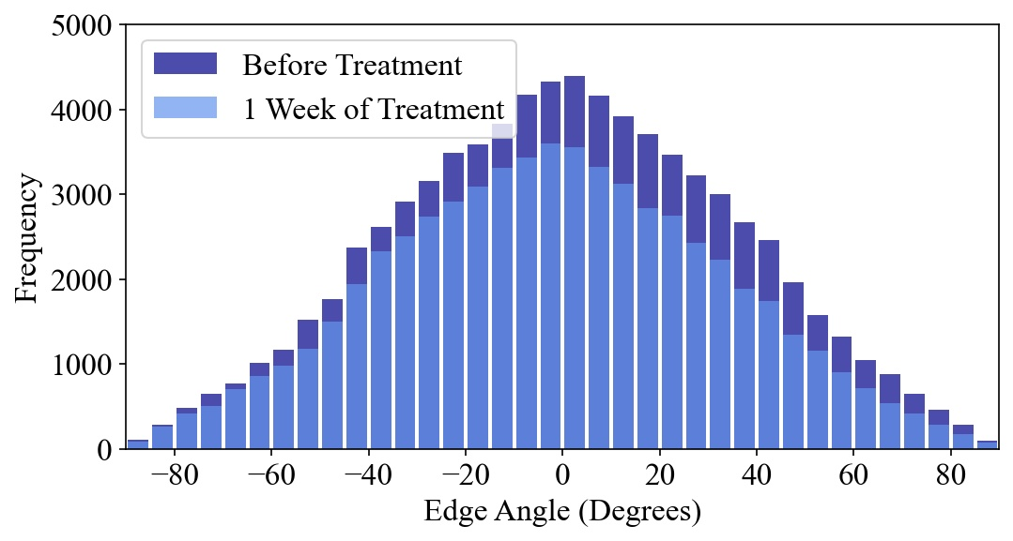
Before Treatment
After 1 Week of Treatment
Histogram of Relative Orientations From -90$°$ to 90$°$

Slide 37
Generated Dataset – Normalised Standard Deviations of Relative Orientations
Treated Hand
Patient | Before | 1 Week | 1 Month | 3 Months | 6 Months | 1 Year | 2 Years | 3 Years | 4 Years
1 | 0,69804 | 0 | 0,23772 | 0 | 0 | 0 | 0,29025 | 0 | 0
2 | 0 | 0,28156 | 0 | 0 | 0,43467 | 0,36525 | 0,50393 | 0 | 0,42806
3 | 0 | 0 | 0 | 0 | 0,25260 | 0,38433 | 0,33108 | 0 | 0,30270
4 | 0,58526 | 0 | 0,14992 | 0 | 0 | 0,29416 | 0 | 0,25833 | 0,27149
5 | 0,67957 | 0,36255 | 0 | 0,34376 | 0 | 0,40972 | 0,47997 | 0,39660 | 0,43313
6 | 0,71281 | 0 | 0,30393 | 0,49919 | 0 | 0,47245 | 0,50885 | 0 | 0,48108
7 | 0 | 0 | 0,27176 | 0 | 0,21851 | 0,33371 | 0,46089 | 0,25351 | 0,31964
8 | 0,52692 | 0 | 0 | 0 | 0 | 0,51366 | 0 | 0 | 0,33659
9 | 0 | 0,49157 | 0,47242 | 0 | 0,76578 | 0 | 0 | 0 | 0
10 | 0,53985 | 0,60501 | 0,61649 | 0 | 0 | 0 | 0,66800 | 0,66869 | 0
11 | 0 | 0 | 0 | 0 | 0 | 0 | 0 | 0 | 0
12 | 0,81357 | 0 | 0,65765 | 0 | 0,52252 | 0,46261 | 0 | 0 | 0
13 | 0,64515 | 0 | 0,11996 | 0,22116 | 0 | 0 | 0,28093 | 0 | 0
14 | 0,58010 | 0 | 0 | 0,54242 | 0 | 0 | 0,49908 | 0,50493 | 0
15 | 0,64107 | 0 | 0 | 0,38314 | 0 | 0 | 0 | 0,39679 | 0
Untreated Hand
Patient | Before | 1 Week | 1 Month | 3 Months | 6 Months | 1 Year | 2 Years | 3 Years | 4 Years
1 | 0,40887 | 0 | 0,36628 | 0 | 0 | 0,25913 | 0 | 0,50348 | 0
2 | 0 | 0,22898 | 0 | 0 | 0,42819 | 0 | 0,61826 | 0 | 0,5444
3 | 0,59158 | 0 | 0 | 0 | 0,34025 | 0,45434 | 0,20970 | 0,27805 | 0,46490
4 | 0,27908 | 0 | 0,38202 | 0 | 0 | 0,34371 | 0,37276 | 0,45124 | 0,25776
5 | 0,28789 | 0,50874 | 0 | 0,41490 | 0 | 0,57673 | 0,54196 | 0,48261 | 0,65204
6 | 0,46463 | 0 | 0,27557 | 0,48461 | 0 | 0 | 0,47006 | 0 | 0,43042
7 | 0 | 0 | 0,38798 | 0 | 0,31109 | 0,42080 | 0,50225 | 0,16933 | 0,33612
8 | 0,28709 | 0 | 0 | 0 | 0 | 0,47970 | 0 | 0 | 0,11800
9 | 0 | 0 | 0 | 0 | 0 | 0,87702 | 0 | 0 | 0
10 | 0,71581 | 0,51664 | 0,54556 | 0,36939 | 0 | 0 | 0,44500 | 0,35811 | 0
11 | 0 | 0 | 0 | 0 | 0 | 0 | 0 | 0 | 0
12 | 0,81730 | 0 | 0,56598 | 0 | 0,66104 | 0 | 0 | 0 | 0
13 | 0,43488 | 0 | 0 | 0,49257 | 0 | 0,58450 | 0 | 0,48633 | 0
14 | 0,74771 | 0 | 0 | 0 | 0 | 0,55042 | 0,76094 | 0 | 0
15 | 0,56392 | 0 | 0 | 0,39887 | 0 | 0 | 0 | 0,45953 | 0

Slide 38
Method 2

Slide 39
Method 2: Overview
1
2
3
4
Reduce noise
PIL Image Python package
Convert to array of coordinates
NumPy Python package
RFFT to remove unwanted frequencies
SciPy Python package
Apply methods 2A and 2B
NumPy and SciPy Python packages

Slide 40
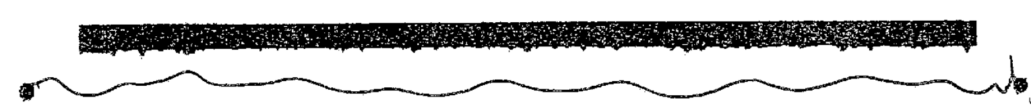
Method 2: Reduce Noise
1
Reduce noise by:
Converting to grayscale
Mapping all pixels to either black or white
https://pillow.readthedocs.io/en/stable/reference/Image.html

Slide 41
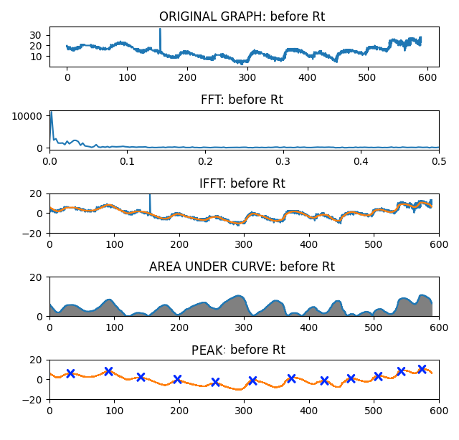
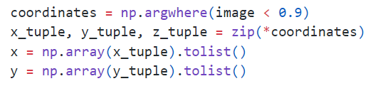
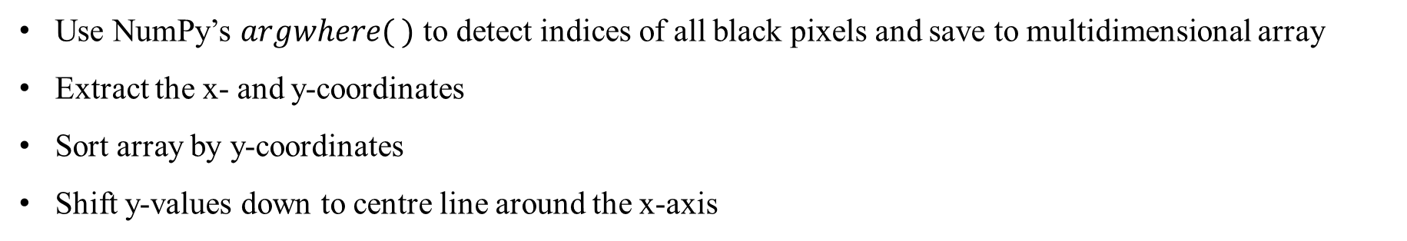
Method 2: Convert to Array
2
Use NumPy’s $argwhere( )$ to detect indices of all black pixels and save to multidimensional array
Extract the x- and y-coordinates
Sort array by y-coordinates
Shift y-values down to centre line around the x-axis
Original line-drawing C
Pixels detected
Shifted pixels
https://numpy.org/doc/stable/index.html

Slide 42
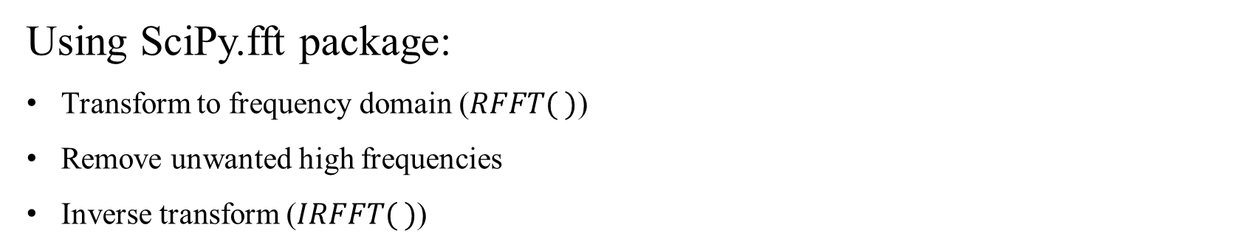
Method 2: RFFT
3
Using SciPy.fft package:
Transform to frequency domain ($RFFT( )$)
Remove unwanted high frequencies
Inverse transform ($IRFFT( )$)
https://docs.scipy.org/doc/scipy/index.html

Slide 43
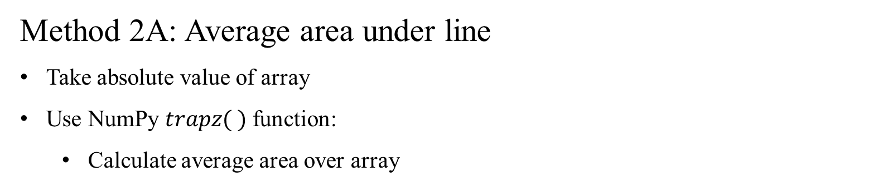
Method 2: Applying Method 2A
4
Method 2A: Average area under line
Take absolute value of array
Use NumPy $trapz( )$ function:
Calculate average area over array
https://numpy.org/doc/stable/index.html

Slide 44
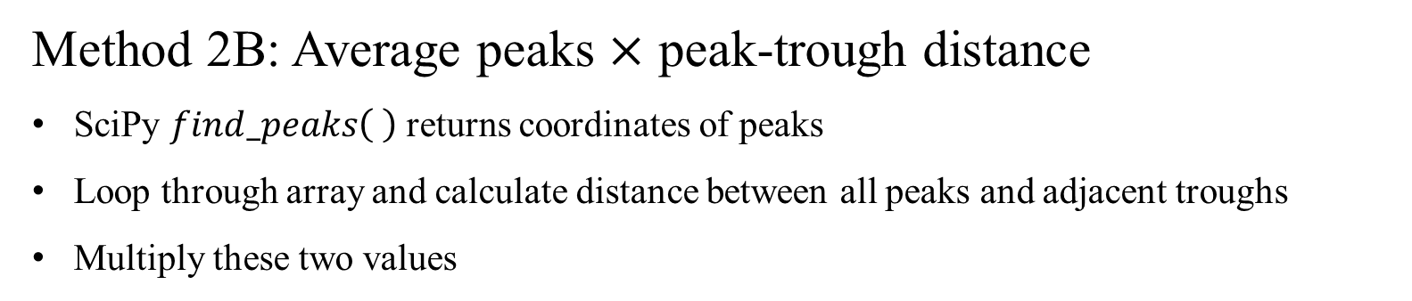
Method 2: Applying Method 2B
4
Method 2B: Average peaks $×$ peak-trough distance
SciPy $find_peaks\left( \right)$ returns coordinates of peaks
Loop through array and calculate distance between all peaks and adjacent troughs
Multiply these two values
https://numpy.org/doc/stable/index.html

Slide 45
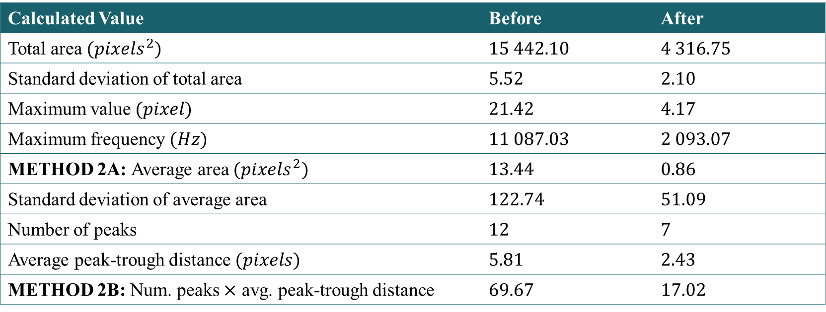
Method 2: Results
Calculated Value | Before | After
Total area $(pixels^{2})$ | $15 442.10$ | $4 316.75$
Standard deviation of total area | $5.52$ | $2.10$
Maximum value $(pixel)$ | $21.42$ | $4.17$
Maximum frequency $(Hz)$ | $11 087.03$ | $2 093.07$
METHOD 2A: Average area $(pixels^{2})$ | $13.44$ | $0.86$
Standard deviation of average area | $122.74$ | $51.09$
Number of peaks | $12$ | $7$
Average peak-trough distance $(pixels)$ | $5.81$ | $2.43$
METHOD 2B: Num. peaks $×$ avg. peak-trough distance | $69.67$ | $17.02$

Slide 46
Method 2: Results
Calculated Value | Before | After
Total area $(pixels^{2})$ | $15 442.10$ | $4 316.75$
Standard deviation of total area | $5.52$ | $2.10$
Maximum value $(pixel)$ | $21.42$ | $4.17$
Maximum frequency $(Hz)$ | $11 087.03$ | $2 093.07$
METHOD 2A: Average area $(pixels^{2})$ | $13.44$ | $0.86$
Standard deviation of average area | $122.74$ | $51.09$
Number of peaks | $12$ | $7$
Average peak-trough distance $(pixels)$ | $5.81$ | $2.43$
METHOD 2B: Num. peaks $×$ avg. peak-trough distance | $69.67$ | $17.02$

Slide 47
Results

Slide 48
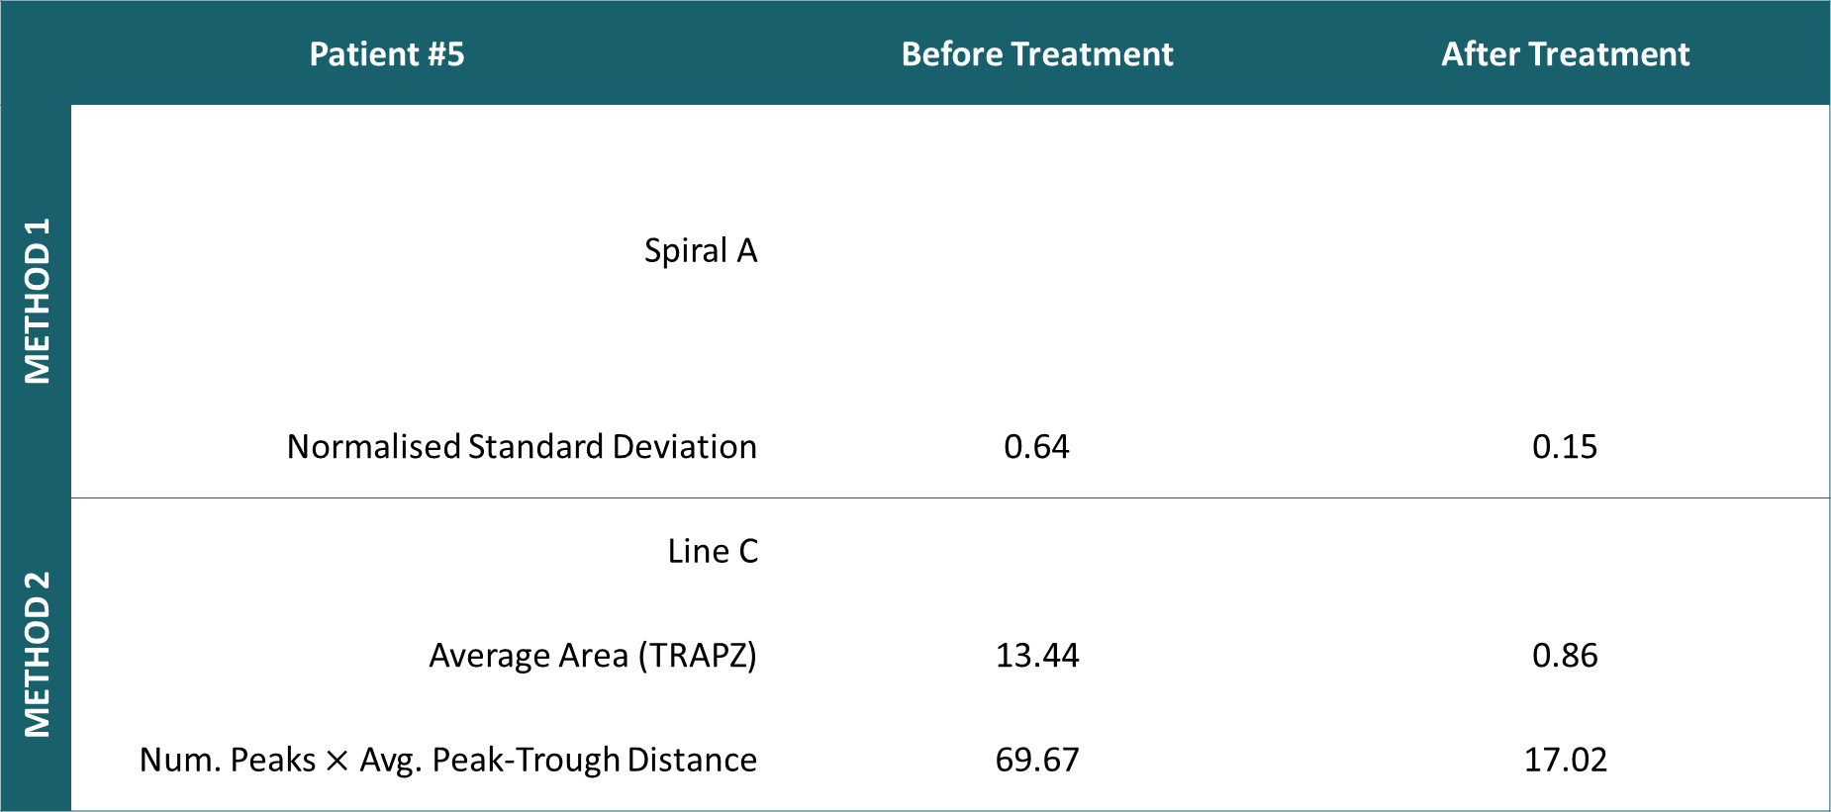
Results: Patient #5 Summary
Patient #5 | Patient #5 | Before Treatment | After Treatment
METHOD 1 | Spiral A
 | Normalised Standard Deviation | 0.64 | 0.15
METHOD 2 | Line C
 | Average Area (TRAPZ) | 13.44 | 0.86
 | Num. Peaks $×$ Avg. Peak-Trough Distance | 69.67 | 17.02

Slide 49
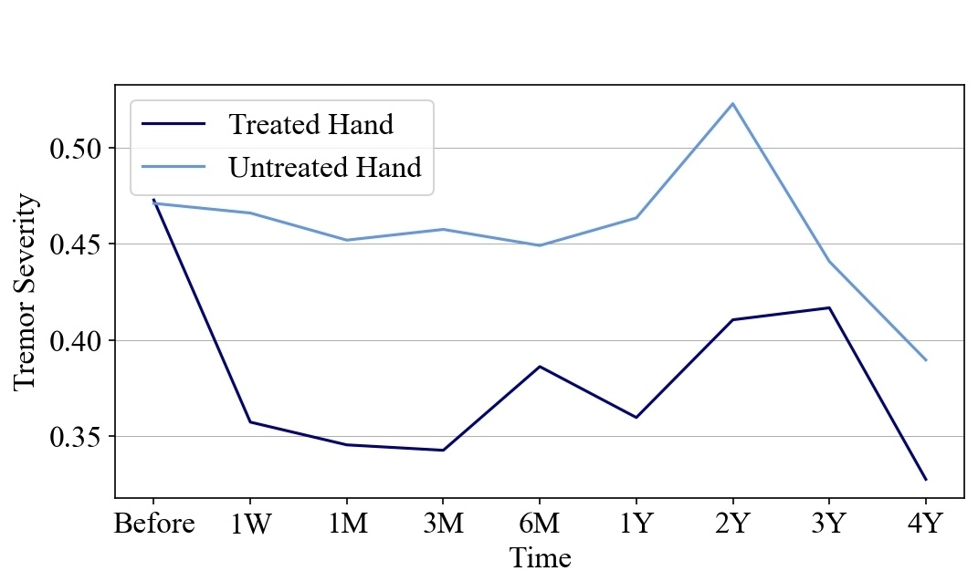
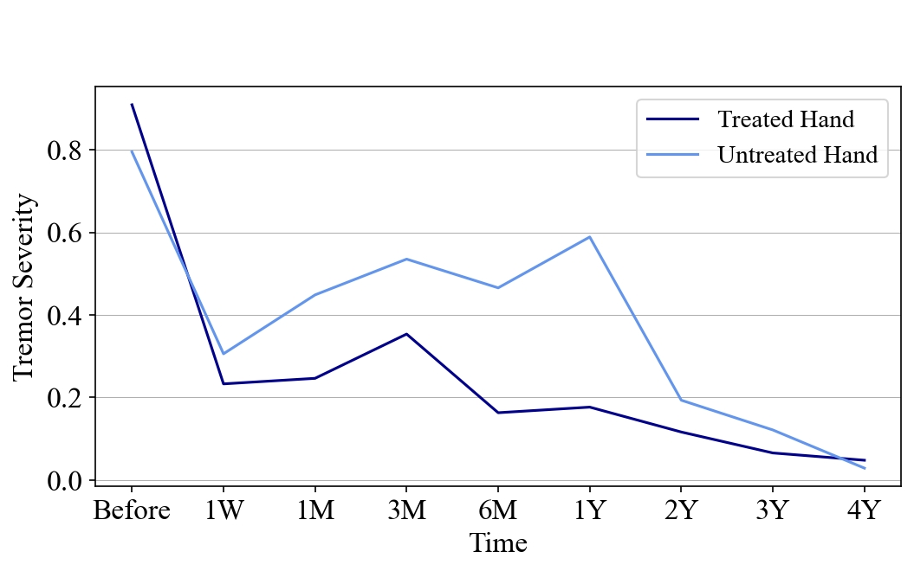
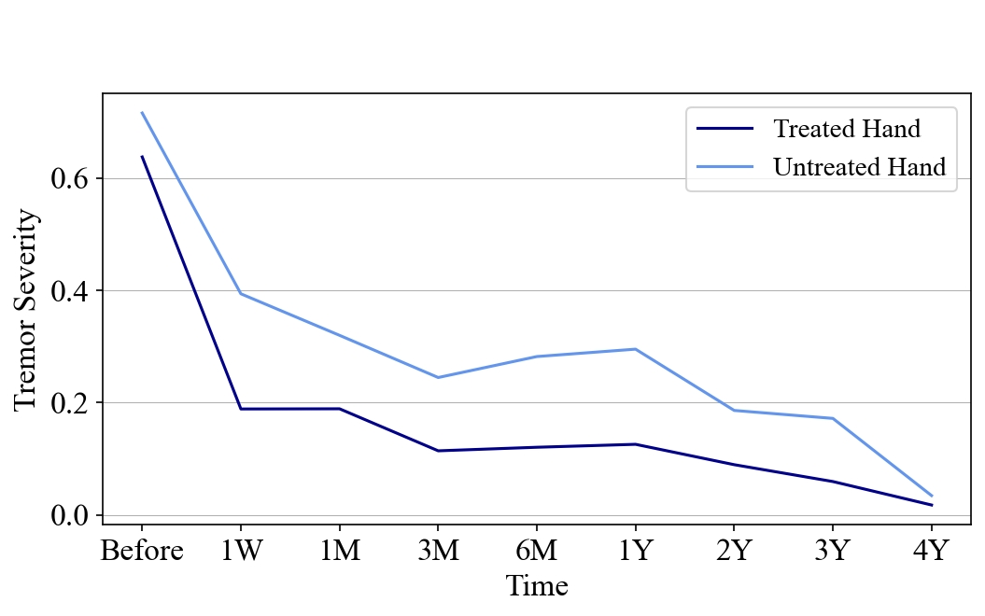

Results: Normalised Average Tremor Severity
Method 2B: Num Peak $×$ Avg. Peak-Trough Distance
Method 1: Spiral Analysis
Method 2A: Average Area

Slide 50
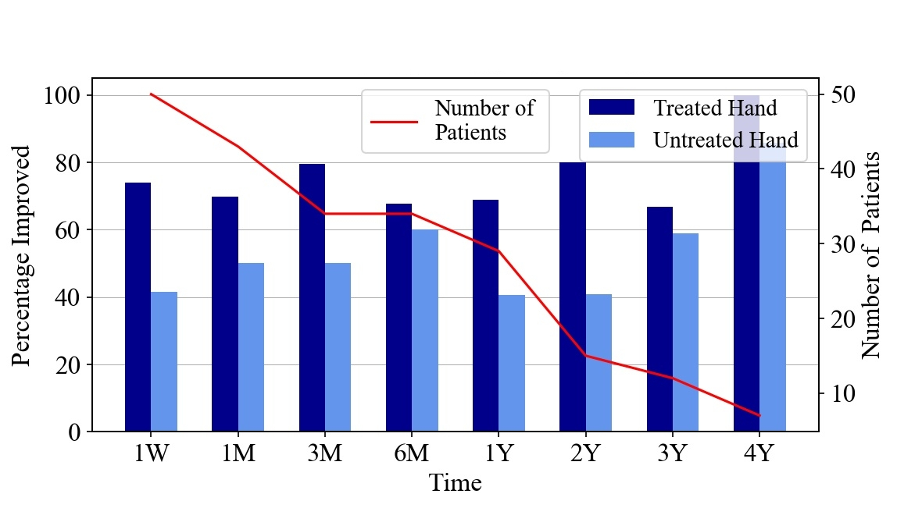
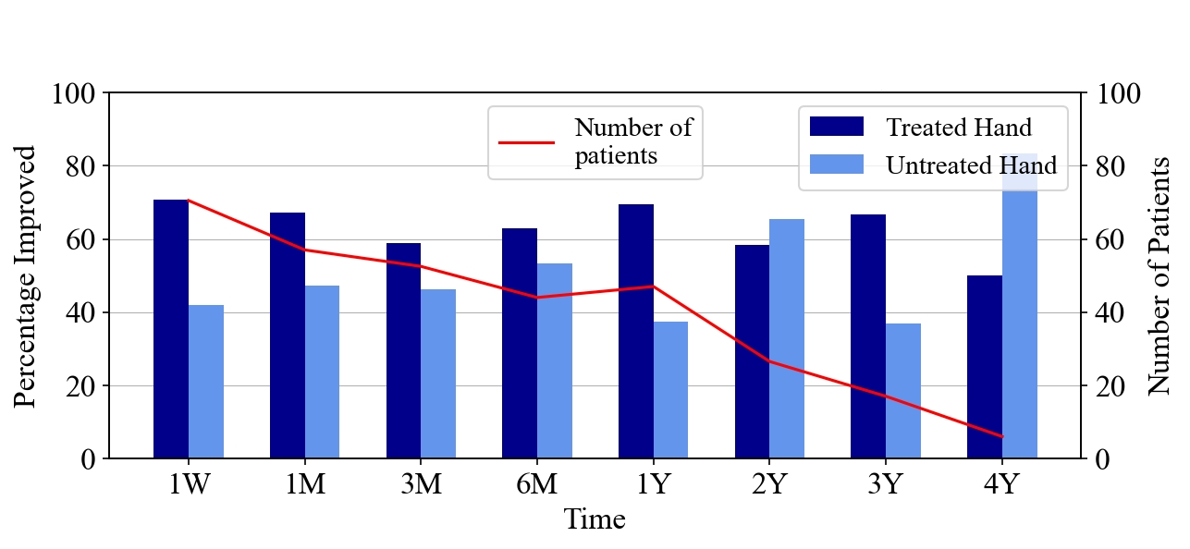
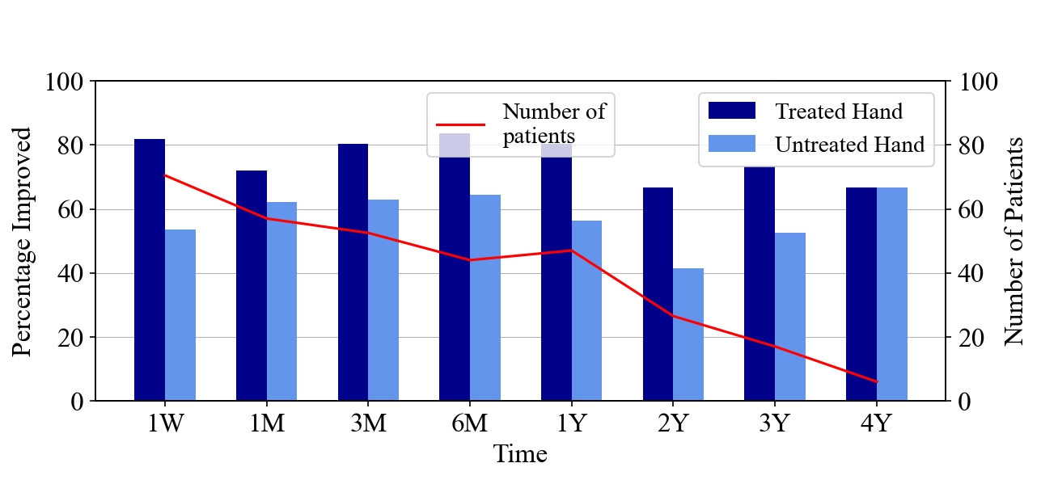
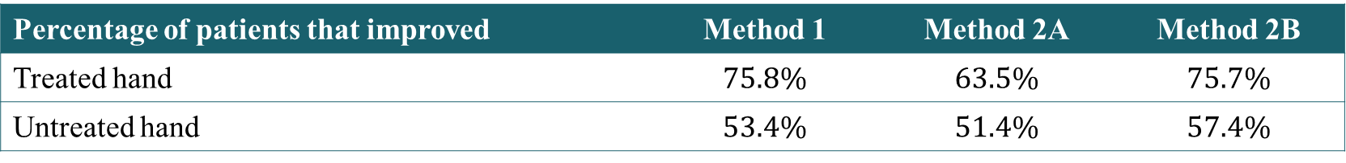

Results: Percentage of Patients with Tremor Before Treatment that Improved After Various Treatment Times
Method 2B: Num Peak $×$ Avg. Peak-Trough Distance
Method 1: Spiral Analysis
Method 2A: Average Area
Percentage of patients that improved | Method 1 | Method 2A | Method 2B
Treated hand | $75.8\%$ | $63.5\%$ | $75.7\%$
Untreated hand | $53.4\%$ | $51.4\%$ | $57.4\%$

Slide 51
Results: Patient #5 Normalised Tremor Severity Rating

Slide 52
Before Treatment
After Treatment

Slide 53
Which Hand?
Robyn Gebbie and Jesse van der Merwe
Project 22P59, Group 22G05

